Slide 1


Corporate Politics The Rise of Partisan Polarization in Firms, 1980-2018
Joshua Gary Mausolf The University of Chicago jmausolf@uchicago.edu jmausolf.github.io

Slide 2
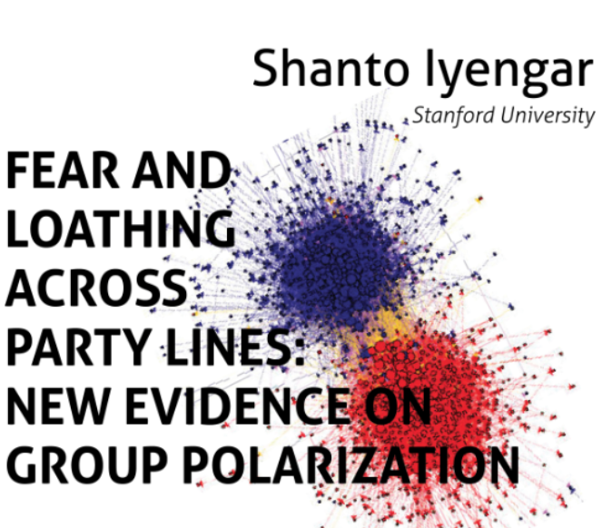
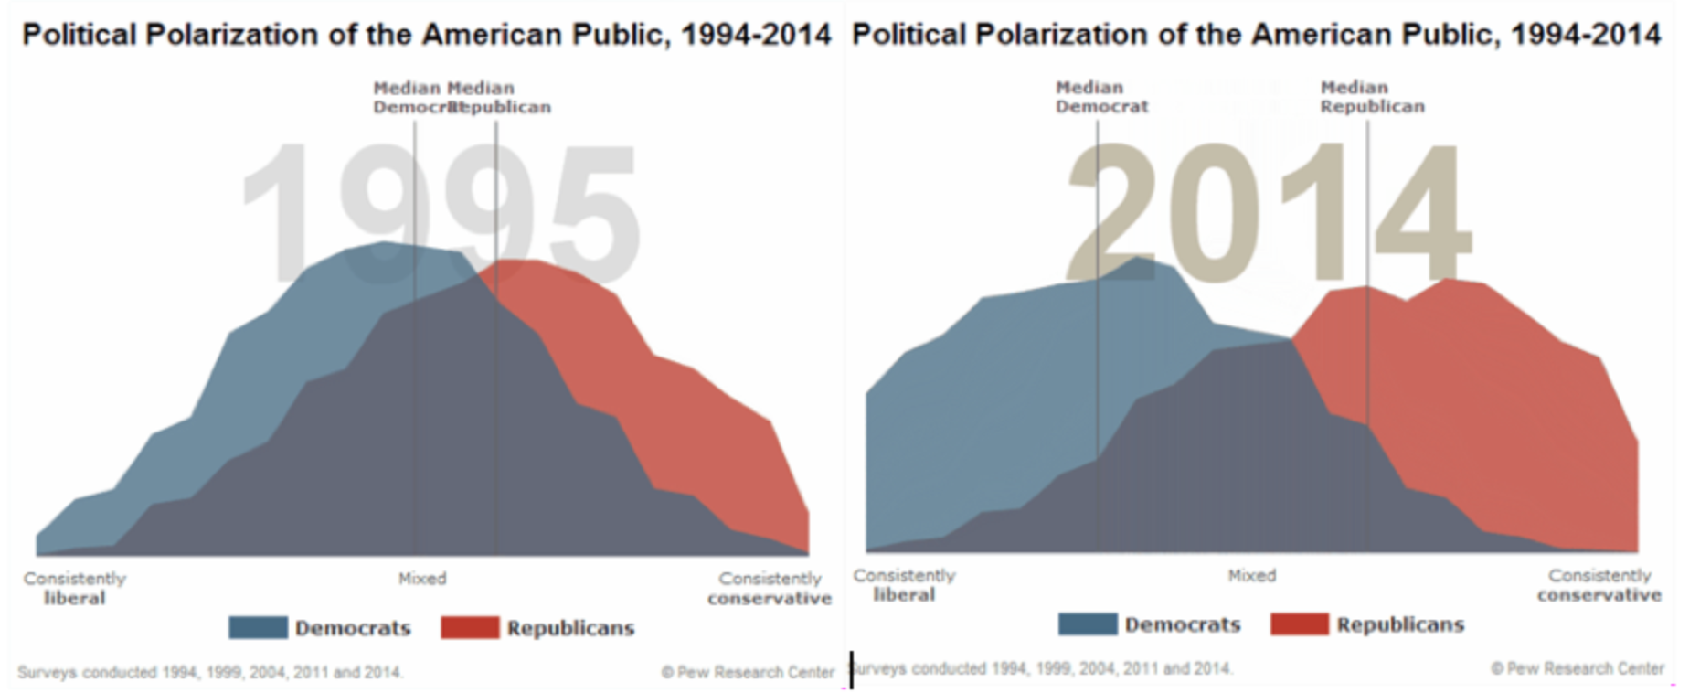
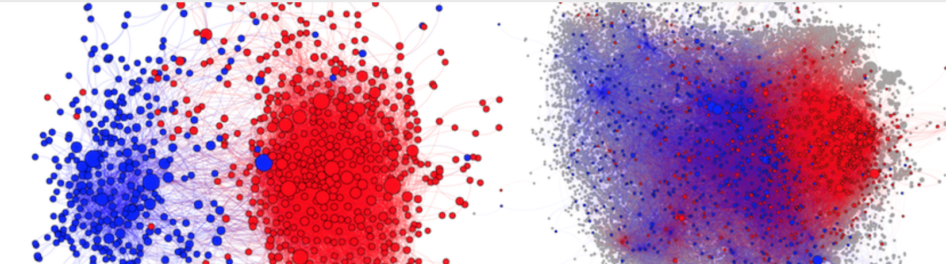
Polarization Trending
Notes:
By now, we have probably all seen the stories of “polarization” splashed across the pages of the news, academic workshops, and journal publications.
Polarization is trending, but it means different things in different contexts
Often, the discussion is focused on Americans broadly, on political elites in congress, or towards social media.
To a lesser extent, though, is polarization, particularly partisan polarization, discussed in relation to organizations, particularly American Fortune 500 firms.
But what is partisan polarization, and how might it manifest in firms and their employees?

Slide 3
What is Partisan Polarization and How Does it Relate to Firms?

Slide 4
Partisan Polarization in the American Firm?
Partisan polarization refers to the phenomenon whereby individuals sort into discrete and increasingly homogeneous political factions (Fiorina and Abrams 2008; Lee 2015).
Related to affective polarization or feelings of hostility toward those of the opposing party (Iyengar and Westwood 2015).
Notes:
Simply put, partisan polarization….
[Explain]
Discrete from political polarization which refers to the spatial distribution of ideological positions (Bonica 2014, 2016; McCarty et al. 2006).
Yet, what does partisan polarization have to do with Fortune 500 companies, and how might partisanship emerge in firms?

Slide 5
Firms and Political Partisanship
Increasingly, matching a firm’s cultural or social context can influence not only hiring behavior (Rivera 2012; Rivera and Tilcsik 2016) but also decisions to terminate employees (Goldberg et al. 2016; c.f. King et al. 2010).
In the workplace, individuals are reluctant to share political views, at least when they conflict with the majority perspective (Cowan and Baldassarri 2018), in part, because of the negative stigma attached to partisan out-groups (Iyengar and Westwood 2015). This creates the appearance but not necessarily the reality of partisan homogeneity.
Such trends suggest partisanship might infiltrate the workforce, but in what ways, has the partisan composition of firms shifted?
Notes:
If we follow the empirical literature, we can see how partisanship might affect individuals in the workplace….
[Explain]
This leads to some motivating questions…

Slide 6
Motivating Questions
Notes:
We can crystallize these theories with a few motivating questions…

Slide 7
Motivating Questions
To what extent does partisan polarization or party sorting emerge in the American corporation?
Can the emergence of firms as political actors be detected through the collective partisan identity of its actor members?
Are such measures of partisanship associated with firm behavior?
Notes:
We know that Americans are becoming increasingly divided along partisan lines, but what effect if any does this phenemenon have in corporations, within firms?
For example, if individuals were randomly allocated into firms and they simply became more partisan, we might expect to see increasingly divided within firm partisan polarization. As partisanship becomes for salient for individuals there would be increasingly contentious partisan environments in the workplace….
However, firm cultural fit, homophily, etc, suggest that for a variety of reasons, individuals often work with like minded people.
However,

Slide 8
Methods
Notes:
To do this, I use a variety of methods.

Slide 9
Methods – High Level Overview
Data Sources: (1) Federal Election Commission (FEC) Data on Individual Campaign Contributions to Political Committees
Data Processing: Data (ETL) Pipeline in Python and SQLite to Determine Individual Partisanship by Firm and Occupation Level
Analysis: Dynamic Time Warping Hierarchical Cluster Analysis, Post-Clustering Analyses in combination with MSCI Environmental, Social, and Governance Data Analysis

Slide 10






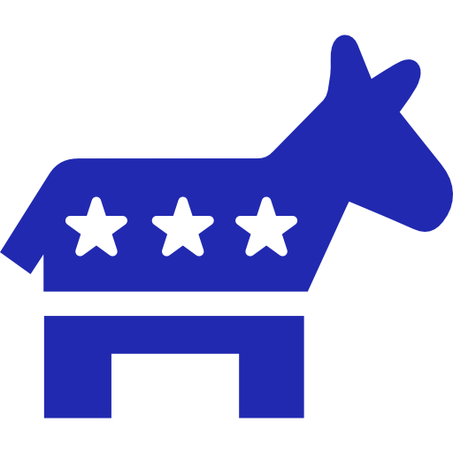
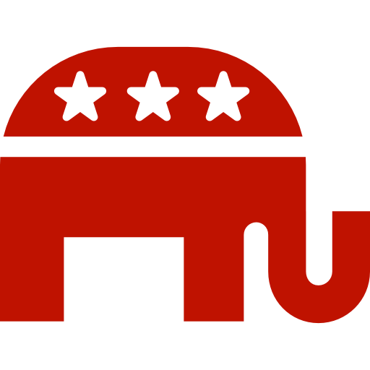

ETL Pipeline Python and SQLite
Federal Election Commission Data
SQL Filter of Individual Contributions for Requested Companies
Determine Party Identities of Political Committees Per Election Cycle
Python, RegEx Quality Control of Companies and Employer Occupations
Build FEC Tables with Individual Contribution Election Cycles
Determine Individuals by Firm and Election Cycle
Notes:
I’ll elaborate on the methodological process. To manage the FEC, I developed an ETL pipeline

Slide 11
All FEC Data Collected
Table 1. Descriptive Statistics of FEC Data Tables, 1980-2018
FEC Table | Total Observations | Years Covered
Committees | 218,482 | 1980-2018
Candidates | 95,807 | 1980-2018
Linkages | 50,775 | 2000-2018
Itemized Records | 9,584,743 | 1980-2018
Contributions to Candidates | 5,122,434 | 1980-2018
Individual Contributions | 54,314,410 | 1980-2018
Operating Expenditures | 10,677,8490 | 1980-2018

Slide 12
Primary FEC Tables Used
Table 1. Descriptive Statistics of FEC Data Tables, 1980-2018
FEC Table | Total Observations | Years Covered
Committees | 218,482 | 1980-2018
Candidates | 95,807 | 1980-2018
Linkages | 50,775 | 2000-2018
Itemized Records | 9,584,743 | 1980-2018
Contributions to Candidates | 5,122,434 | 1980-2018
Individual Contributions | 54,314,410 | 1980-2018
Operating Expenditures | 10,677,8490 | 1980-2018

Slide 13
ETL Pipeline Python and SQLite
Federal Election Commission Data
SQL Filter of Individual Contributions for Requested Companies
Determine Party Identities of Political Committees Per Election Cycle
Python, RegEx Quality Control of Companies and Employer Occupations
Build FEC Tables with Individual Contribution Election Cycles
Determine Individuals by Firm and Election Cycle
Notes:
The Second of These Steps, Determining the Party Identities of Political Committee’s Deserves Further Attention

Slide 14



What Party is Associated with an Individual Contribution?
Individual Contributions
Political Committee
Partisanship

Slide 15
Determining the Partisan Profile of a Political Committee
FEC Data Sources
Political Committee
1. Committee Party Affiliation
2. Candidate Party Affiliation
3. Itemized Contributions to Other Committees
{repeat steps 1-3 for each itemized committee}

Slide 16
ETL Pipeline Python and SQLite
Federal Election Commission Data
SQL Filter of Individual Contributions for Requested Companies
Determine Party Identities of Political Committees Per Election Cycle
Python, RegEx Quality Control of Companies and Employer Occupations
Build FEC Tables with Individual Contribution Election Cycles
Determine Individuals by Firm and Election Cycle

Slide 17
Data for Fortune 400 Companies
Data for Filtered Fortune 400 Companies, Post Quality Control (ETL) 1980-2018
Data Level | Total Observations | Years Covered
Individual Contributions | 3,863,893 | 1980-2018
Individuals x Firm x Election Cycle | 562,473 | 1980-2018
Firms | 336 | 1980-2018
Notes:
Yet, both the number of individuals and their contribution patterns are not evenly distributed…

Slide 18
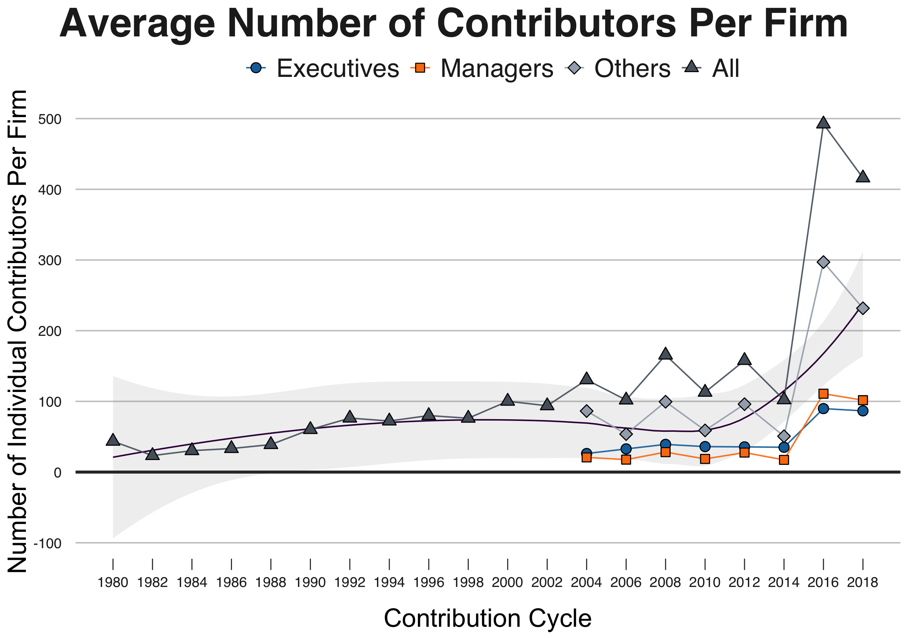
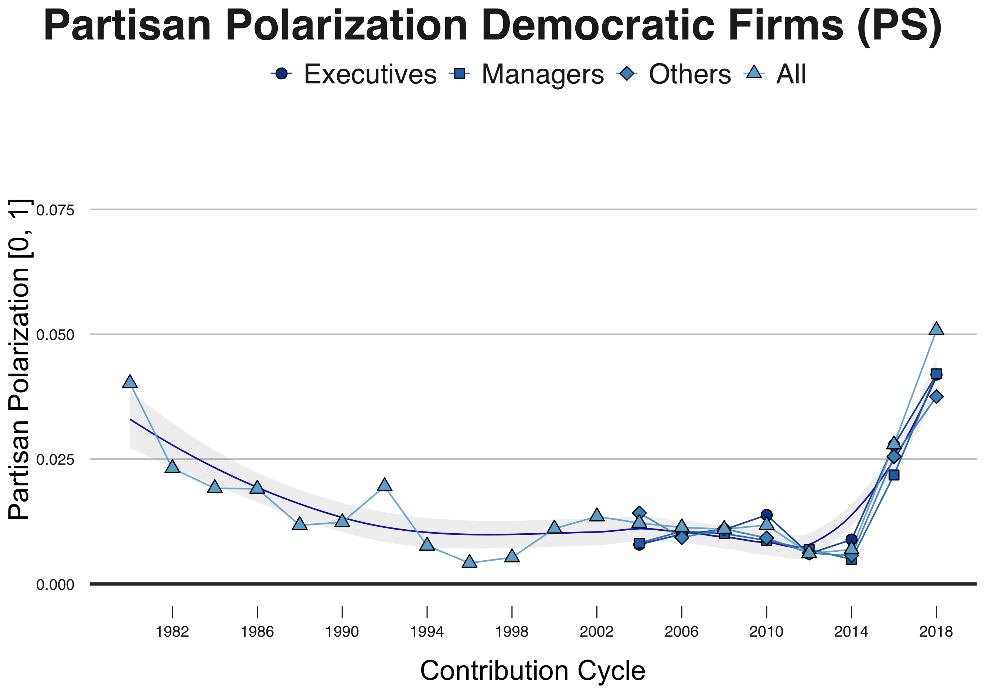
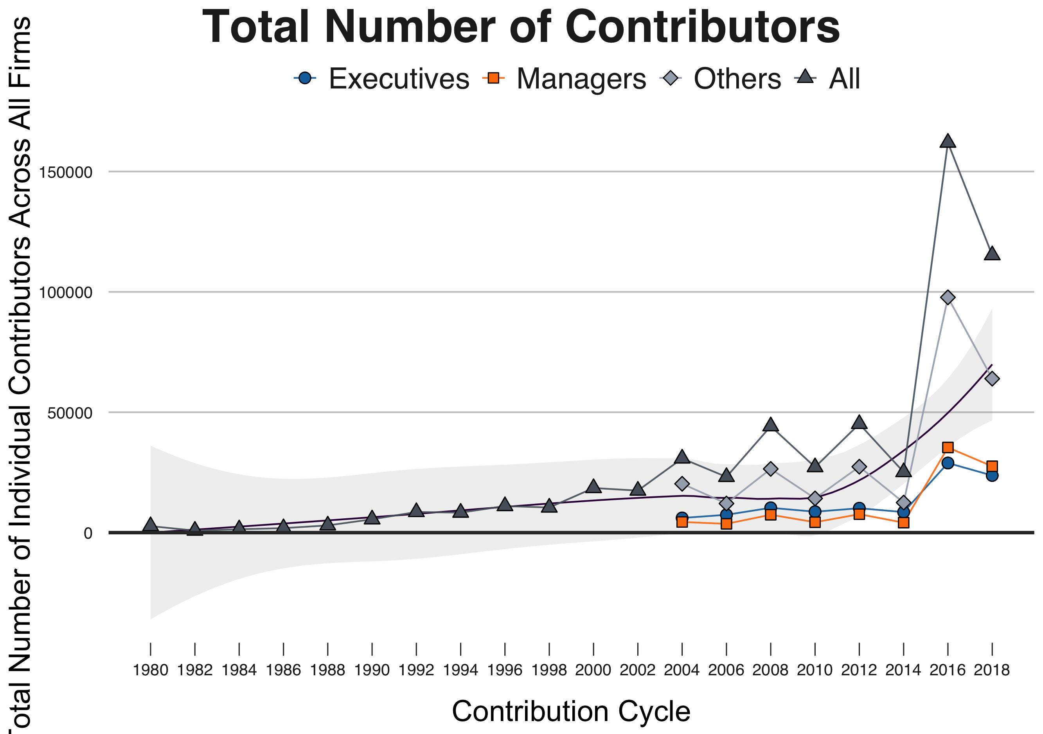
Increasing Individual Contributors Since 2014
Average Individuals Per Firm
Total Individual Contributors
Notes:
Instead, while both the number of individuals per firm and the total number of individual partisans at each company gradually increases through the 2000’s, after 2014 and during the 2016 election cycle, the number of contributors dramatically increases
This perhaps suggests that among other possible mechanisms, the partisanship of existing employees within these firms was activated, becoming increasingly salient during this time

Slide 19
The Rise of Partisan Polarization in Firms?
Notes:
Yet, if employees partisanship is activated at this time, do we also see a rise in partisan polarization (or increased within firm partisan homogeneity) at the same time?

Slide 20
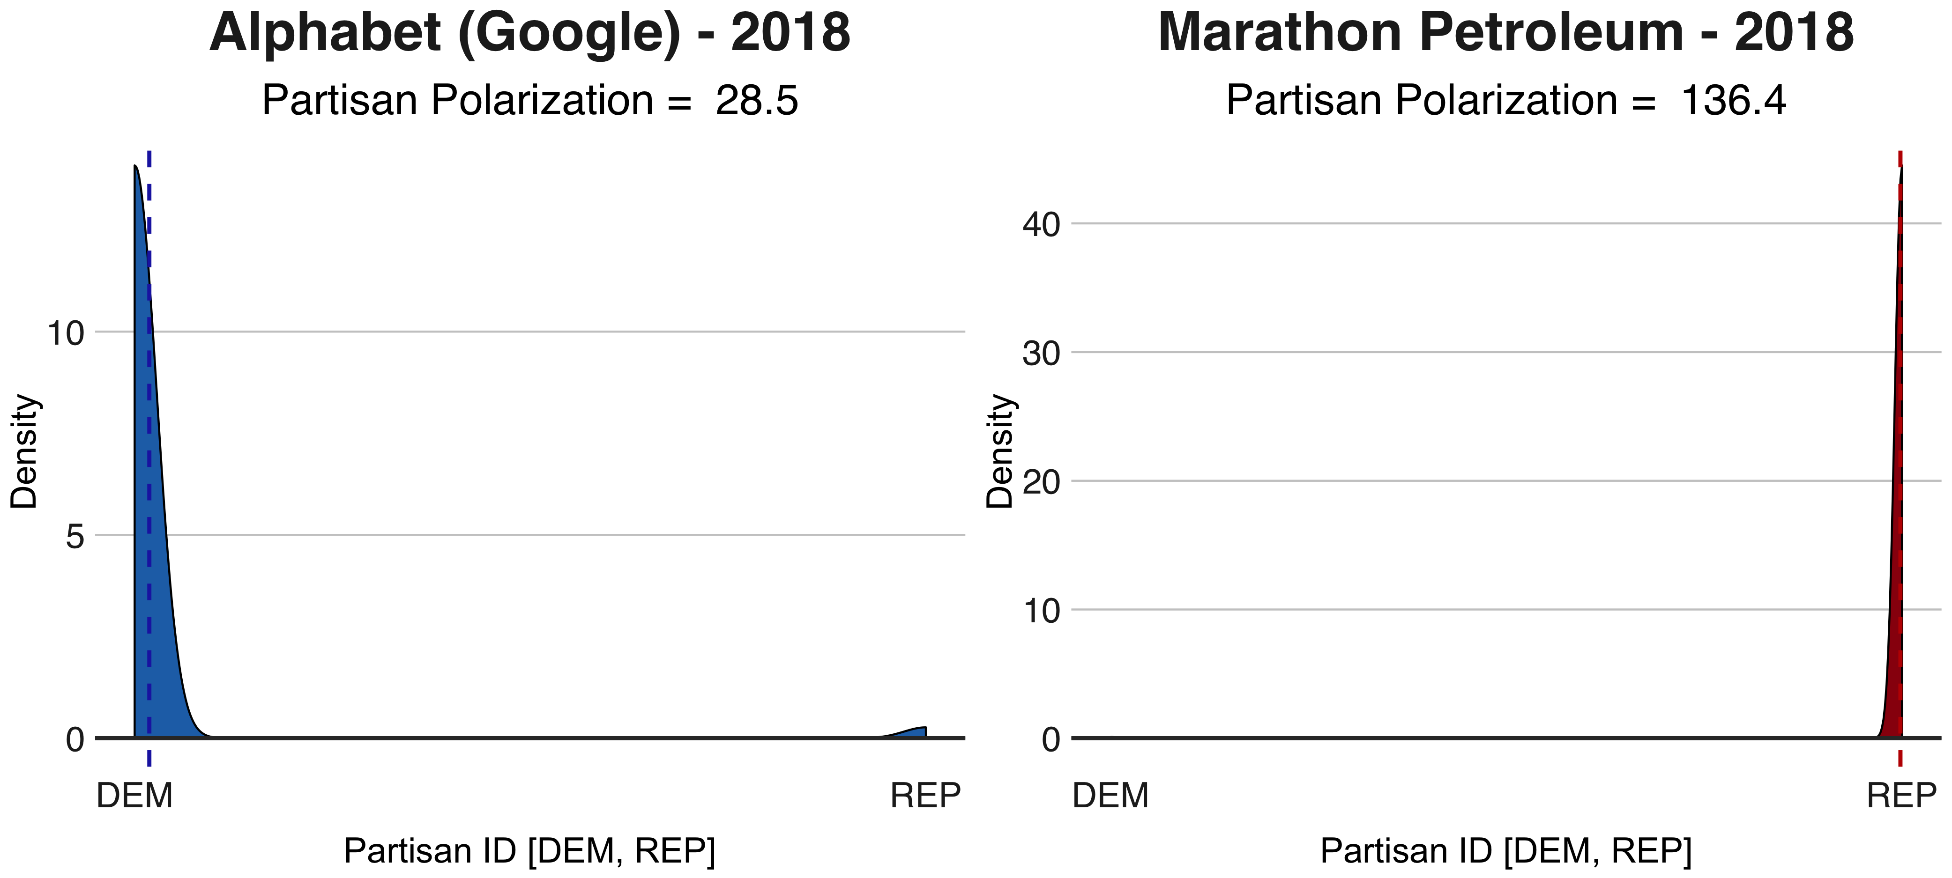
Measuring Partisan Polarization
Partisan Polarization = ( (1 − Var[X]) x | Skew[X] | x ln (Kurt[X] + 10) ),
where X = Party ID or Partisan Polarization
Notes:
Before we can answer this question, we need to better clarify what we mean by partisan polarization
For partisan polarization, we are especially interested in how tightly employees are clustered around a particular partisan pole…In other words, what is the degree of partisan homogeneity within a firm?
I developed a measure that incorporates several measures of dispersion (2nd, 3rd, and 4th moments) or variance, skew, and kurtosis.

Slide 21
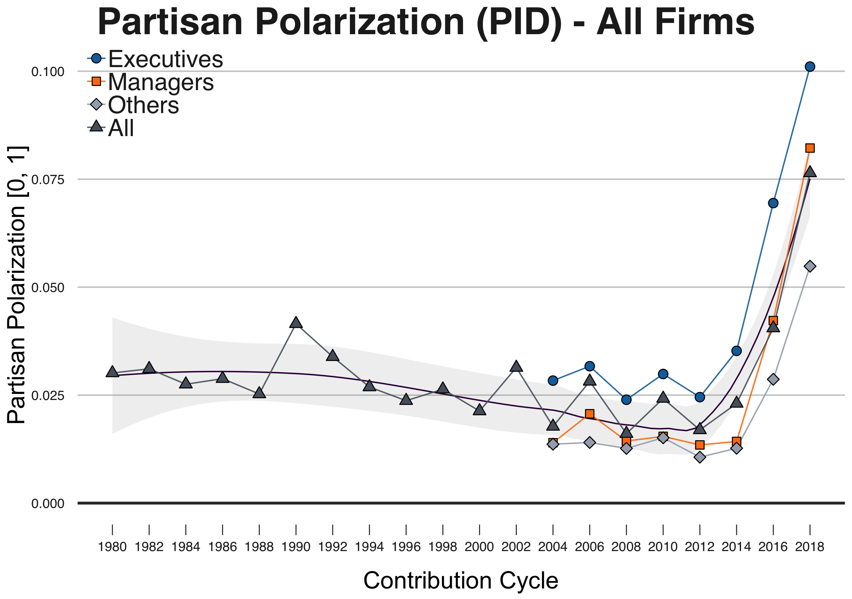
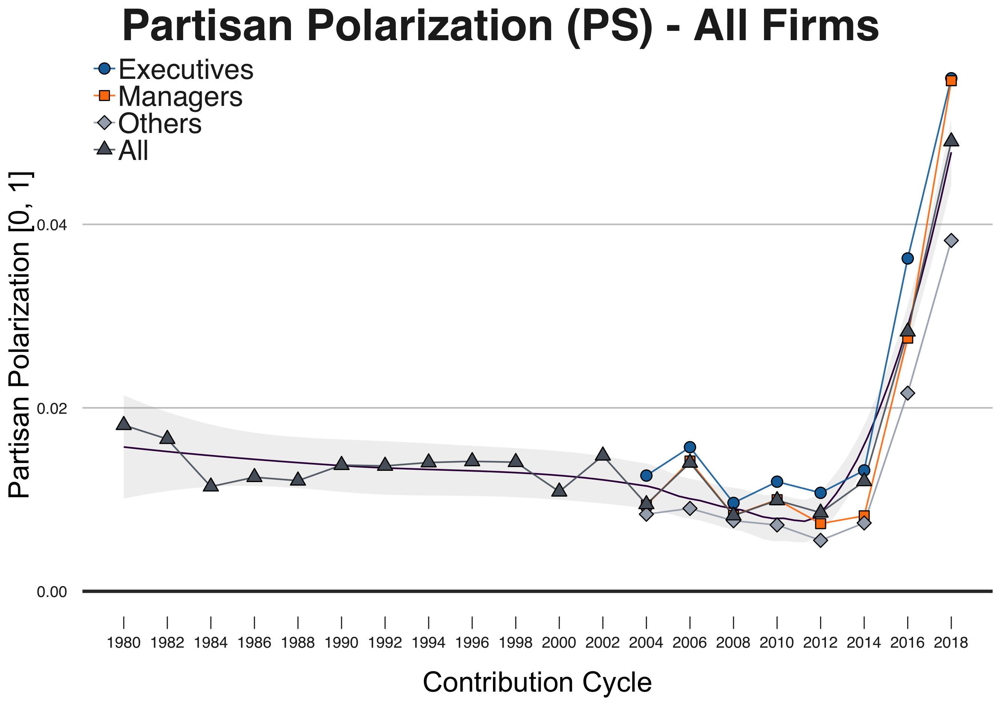
Partisan Polarization in Fortune 400 Firms, 1980-2018
Partisan Polarization (Party ID)
Partisan Polarization (Partisan Score)
Notes:
So, using this measure, has partisan polarization (within firm partisan homogeneity) increased over time?

Slide 22
Can We Classify Discrete Types of Partisan Firms?

Slide 23
Dynamic Time Warping – Hierarchical Cluster Analysis
Hierarchical Cluster Analysis: (AGNES/DIANA) Used in Sociological Studies of Emergence (Powel and Sandholtz 2012; Ruef 2000)
Dynamic Time Warping: A model-free dissimilarity measure that can minimize a temporal mapping across a matrix of multivariate time series (Bernd and Clifford 1994; Montero and Vilar 2014).
Clustering is unsupervised and the number of clusters must be specified.

Slide 24
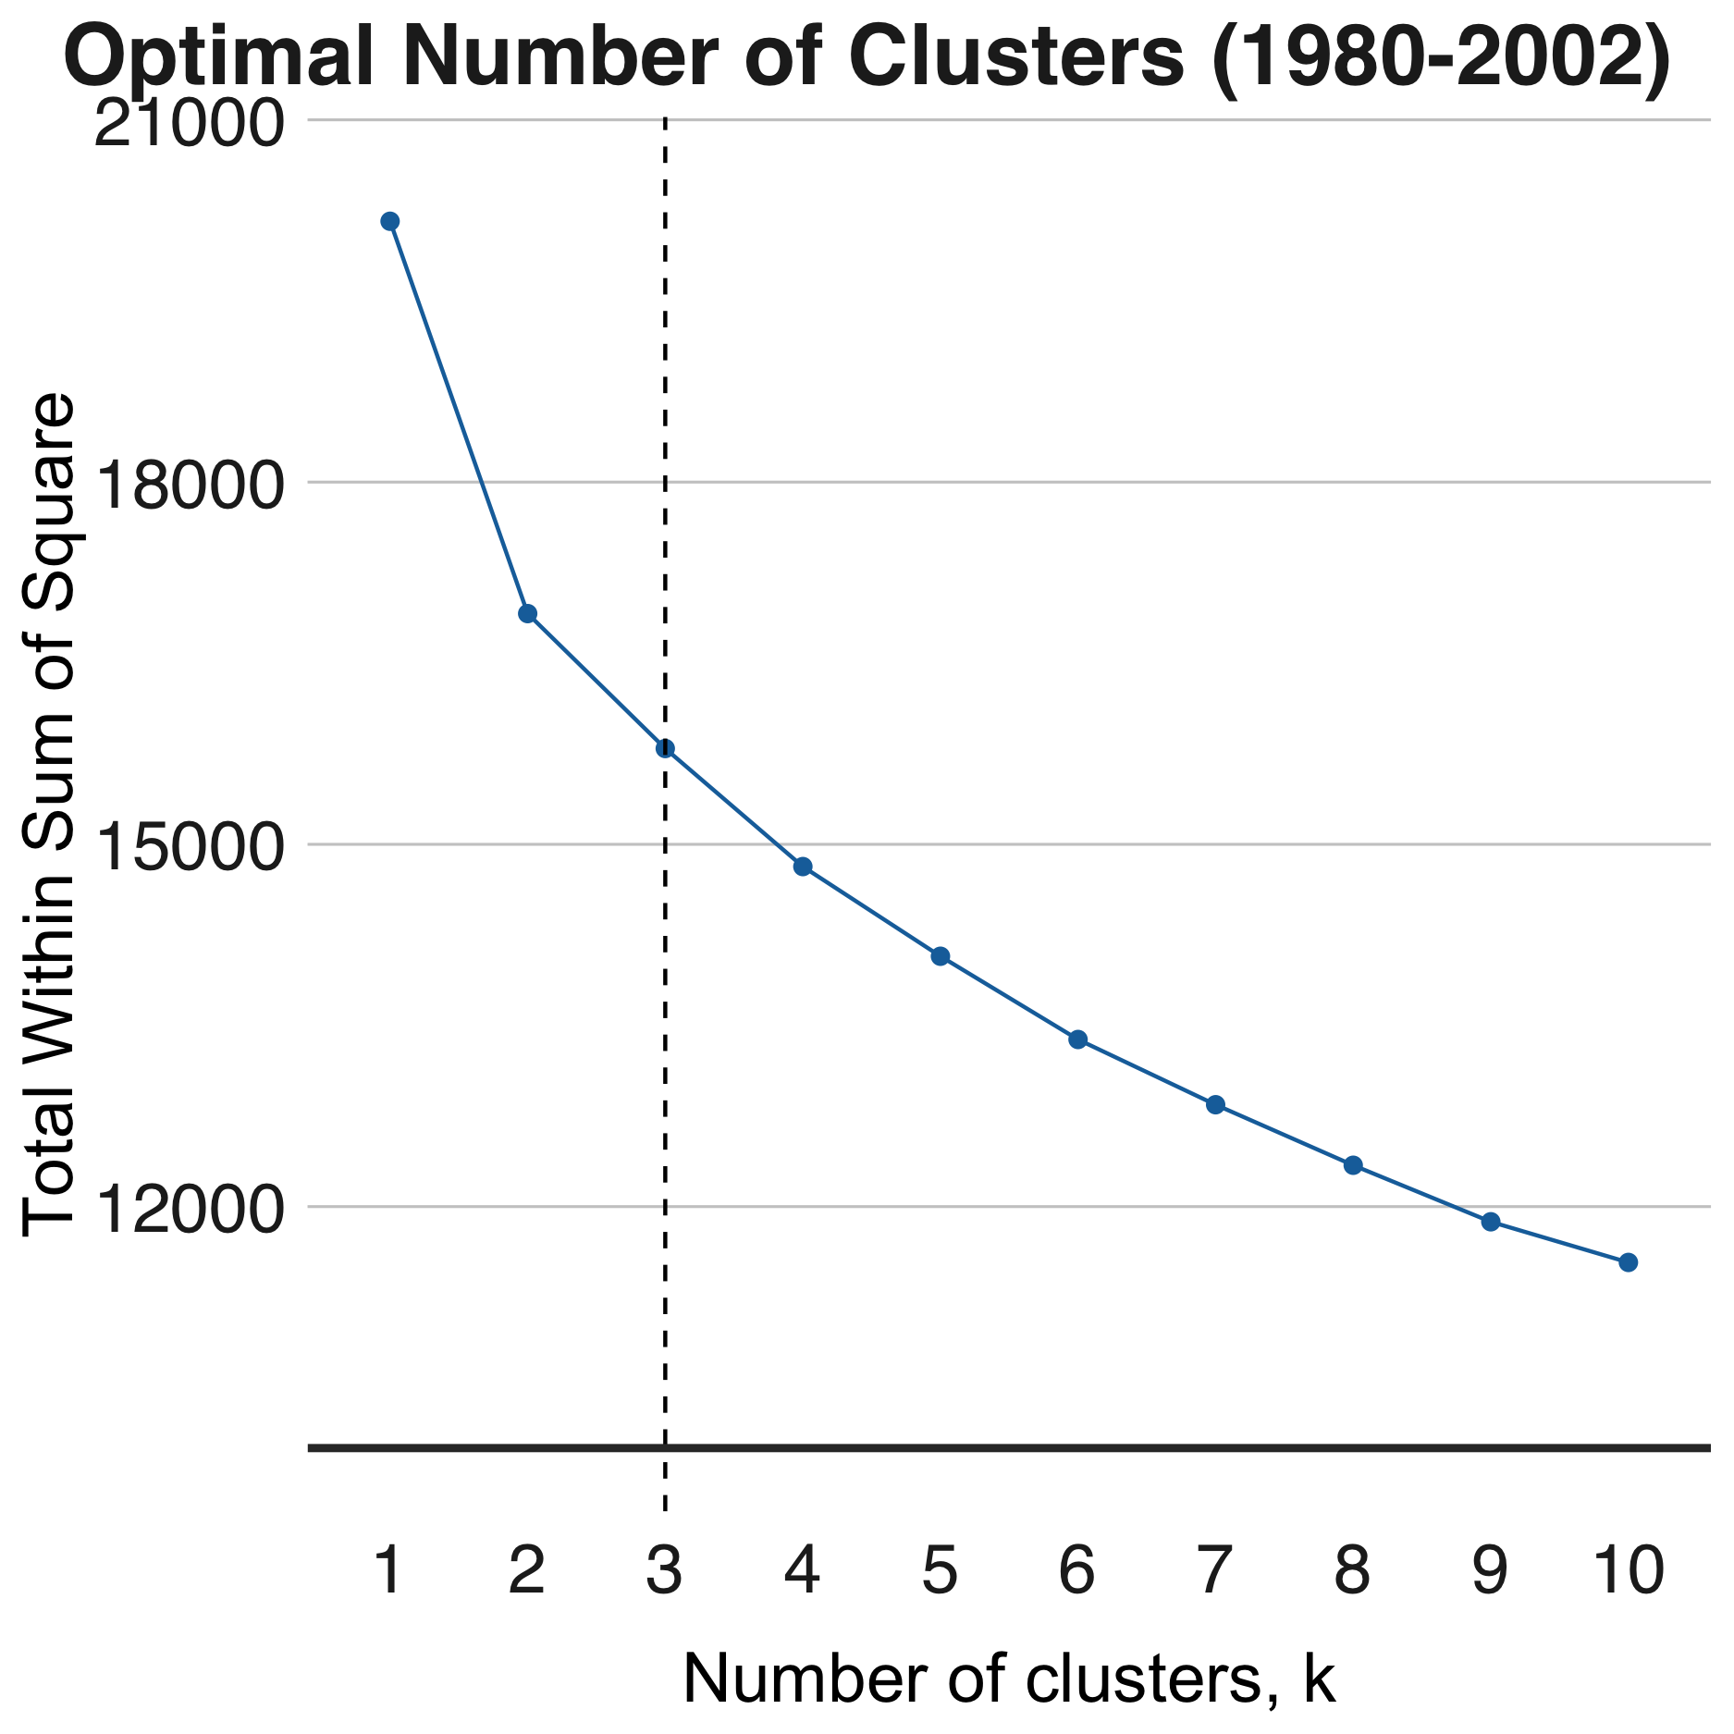
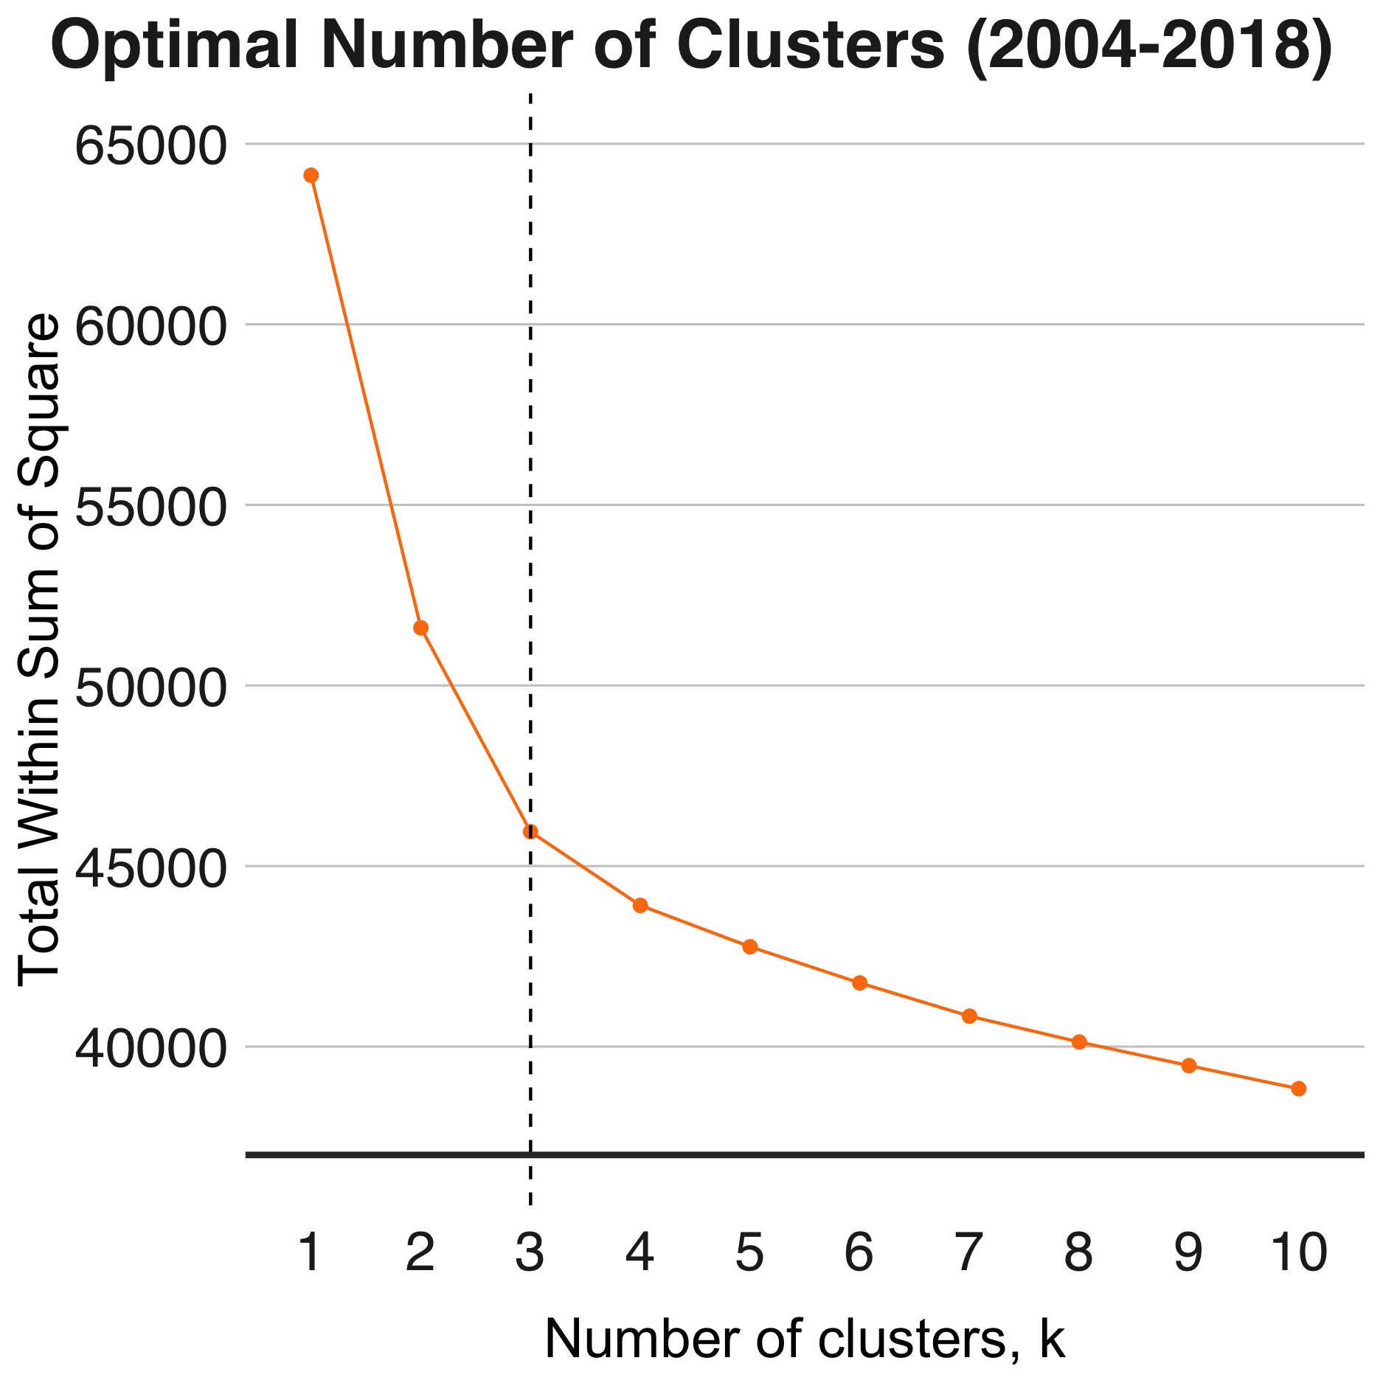
AGNES Models: Optimal Number of Clusters AGNES Models Run Using Ward Method
AGNES 1980-2002
AGNES 2004-2018
Notes:
When running HCA models, the number of clusters, K, must be specified. Testing revealed that K=3 clusters, was optimal

Slide 25
Dynamic Time Warping Hierarchical Clustering Algorithm Selection, 1980-2018
 | Model Coefficients
HCA Method | Model 1 | Model 2 | Model 3
AGNES, UPGMA | 0.656 | 0.646 | 0.705
AGNES, WPGMA | 0.703 | 0.688 | 0.753
AGNES, Single Linkage | 0.622 | 0.608 | 0.707
AGNES, Complete Linkage | 0.807 | 0.8 | 0.848
AGNES, Ward’s Method | 0.921 | 0.919 | 0.916
Diana | 0.763 | 0.751 | 0.819
Notes:
Similarly, a number of different feature inputs were considered for the models. In the end, models performed similarly and I elected to select Model 1, which incorporates a variety of measures of central tendency regarding partisanship at discrete levels of occupational hierarchy by election cycle.

Slide 26
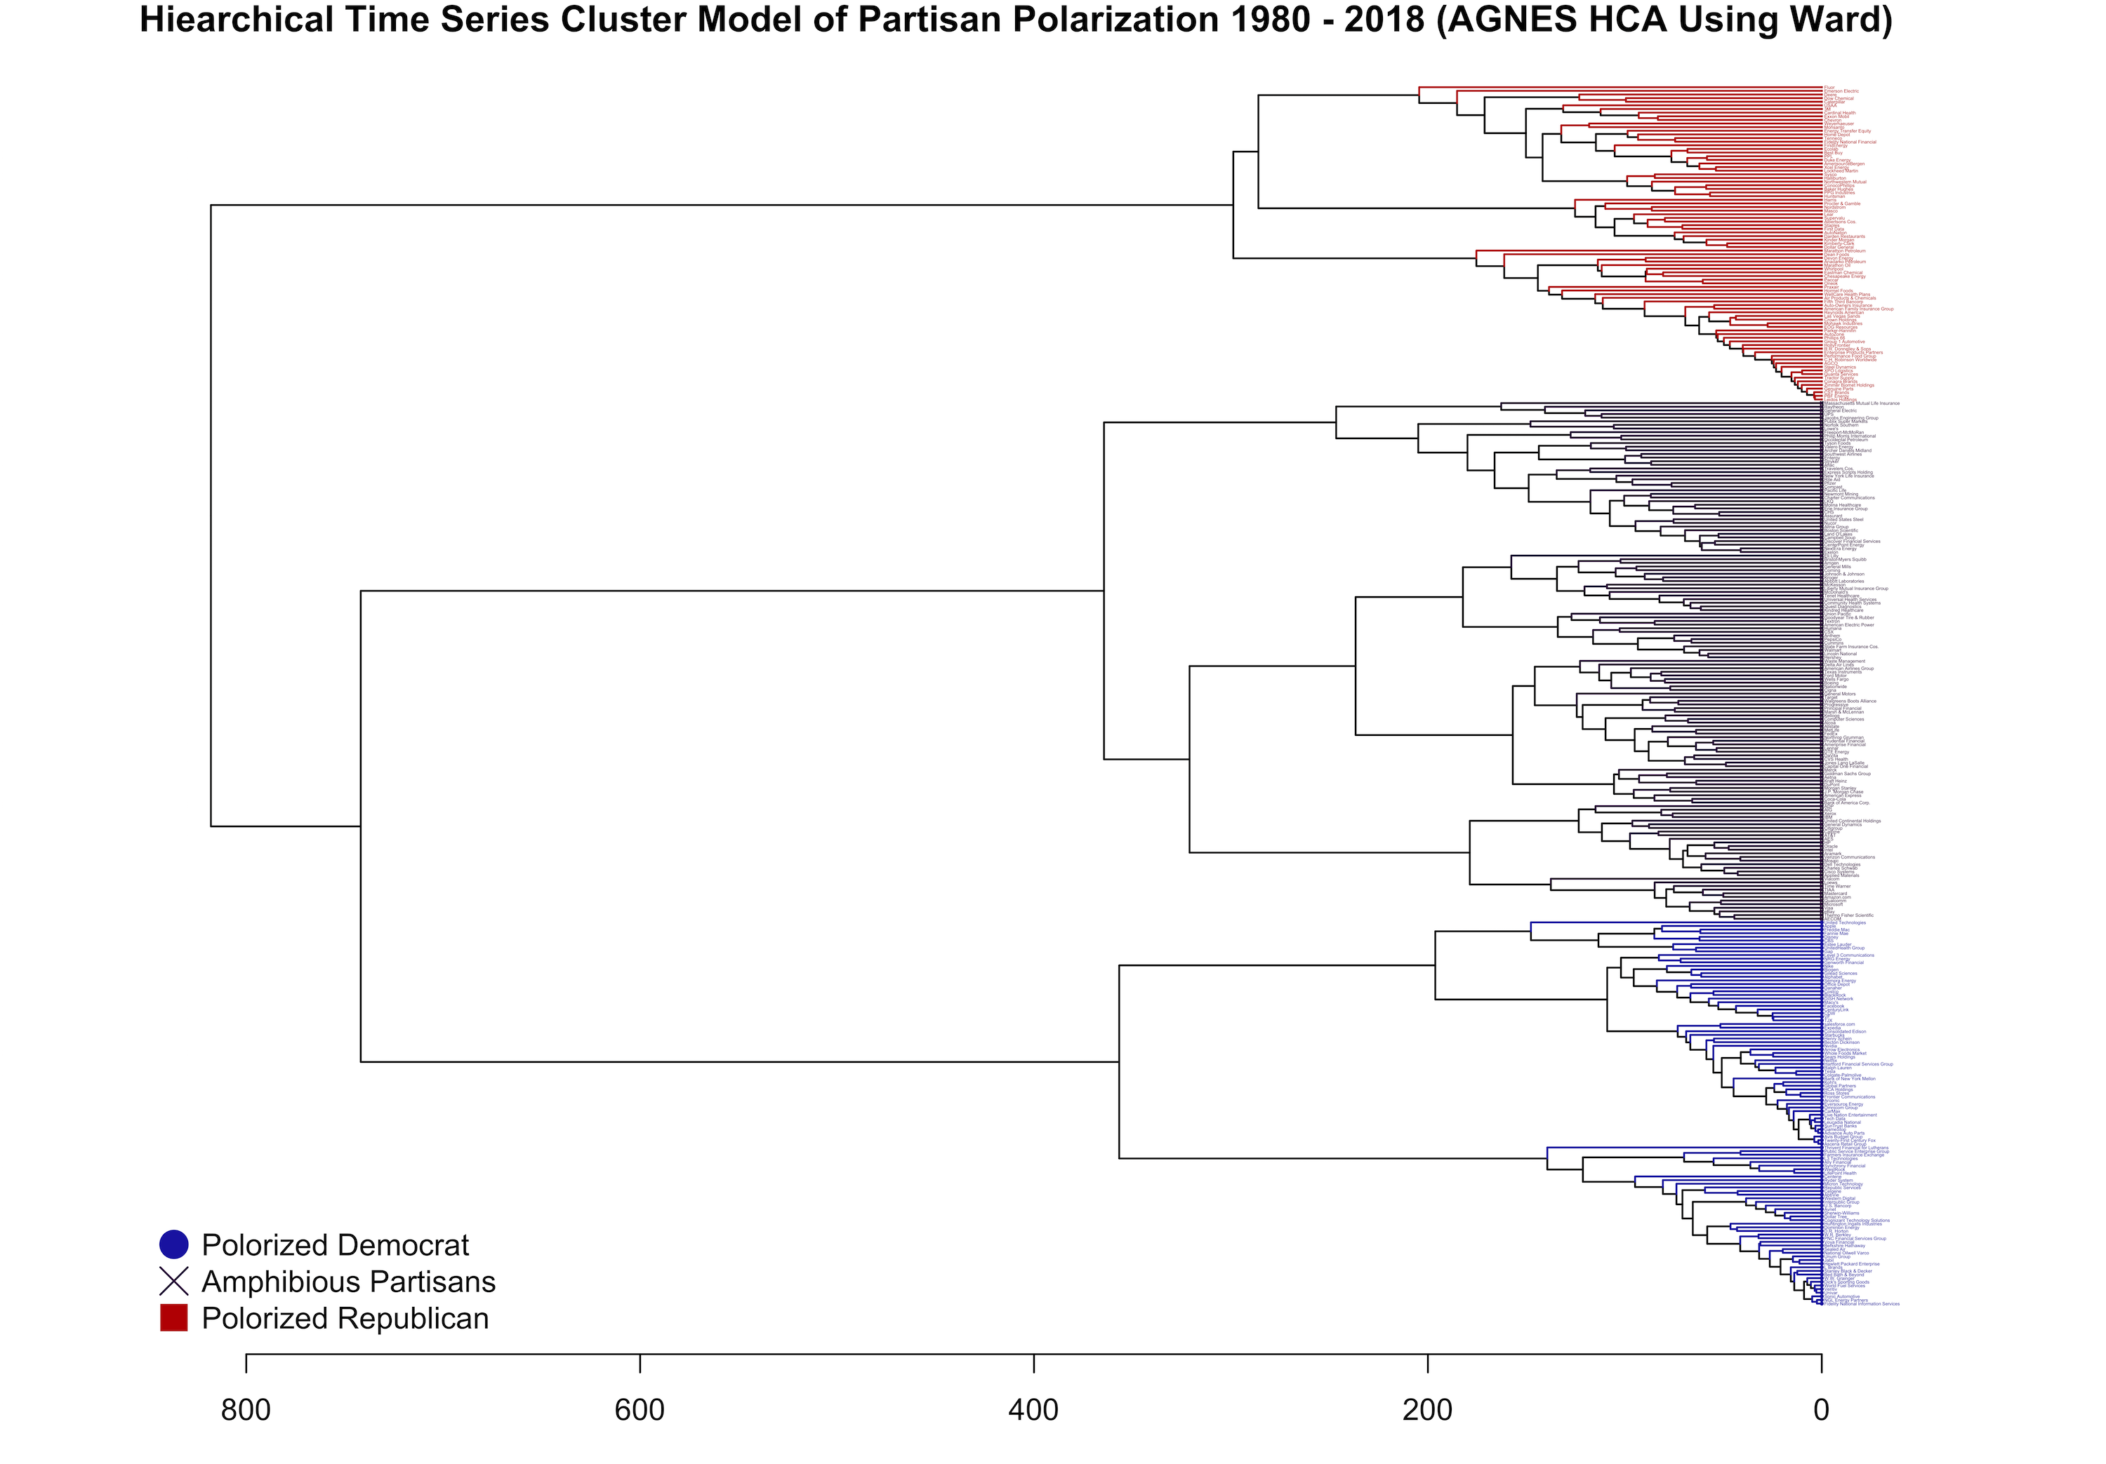
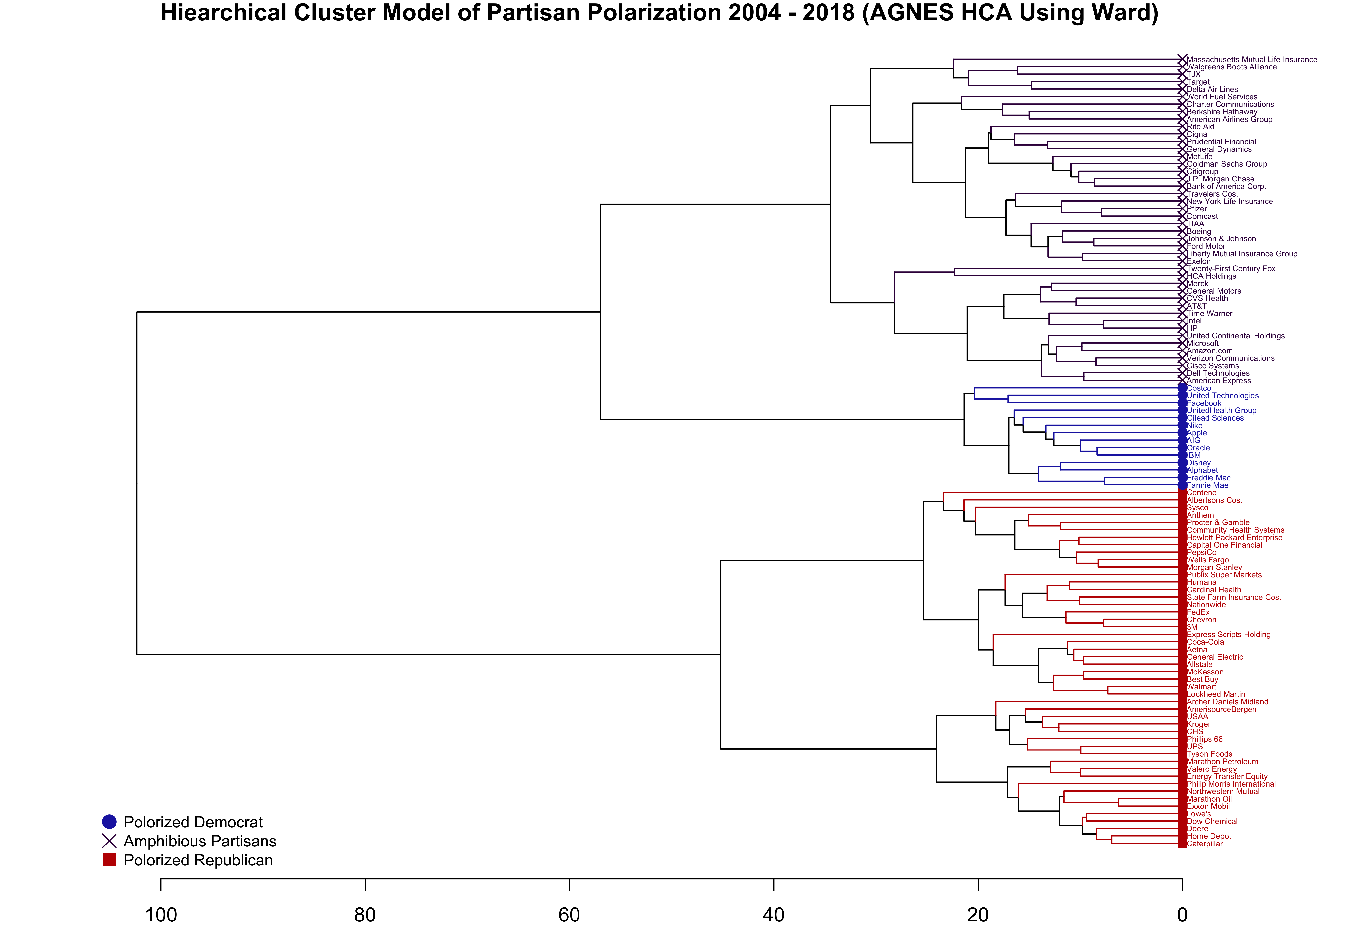
Dynamic Time Warping AGNES-Ward Model: 1980-2018
Republican Firms include:
Marathon Petroleum
Marathon Oil
Exxon Mobil
Anadarko Petroleum
Monsanto
Dean Foods
Hormel Foods
Caterpillar
Home Depot
USAA
Notes:
Examining the model, we can see the following results…
AGNES Models Run with 2004-2018 Period, Polarization Assessed for Respective Clusters for 1980-2018

Slide 27
Dynamic Time Warping AGNES-Ward Model: 1980-2018
Amphibious Firms include:
General Mills
Coca-Cola
Hershey
McDonalds
Goldman Sachs
J.P. Morgan Chase
General Electric
Ford Motor
Boeing
American Airlines
Wal-Mart
Kroger
Notes:
AGNES Models Run with 2004-2018 Period, Polarization Assessed for Respective Clusters for 1980-2018

Slide 28
Dynamic Time Warping AGNES-Ward Model: 1980-2018
Democratic Firms include:
Alphabet (Google)
Apple
Netflix
Tesla
Nike
Disney
Starbucks
Whole Foods
Estee Lauder
Ralph Lauren
Macy’s
Salesforce
Notes:
AGNES Models Run with 2004-2018 Period, Polarization Assessed for Respective Clusters for 1980-2018

Slide 29
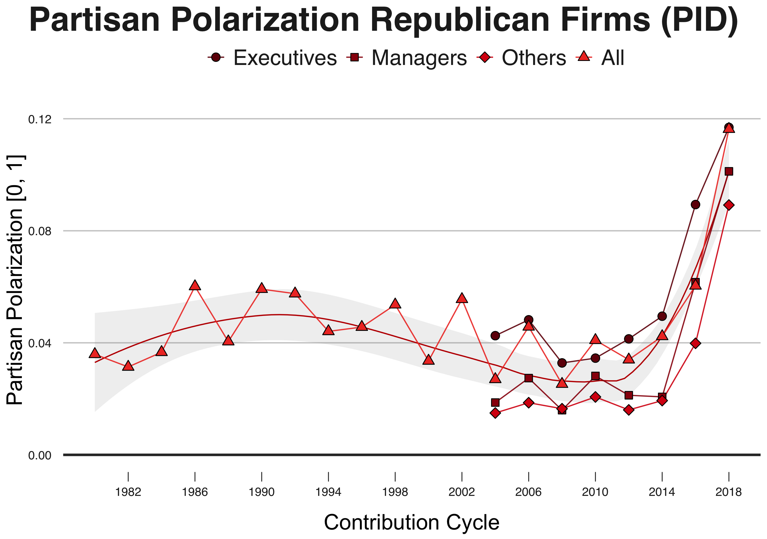
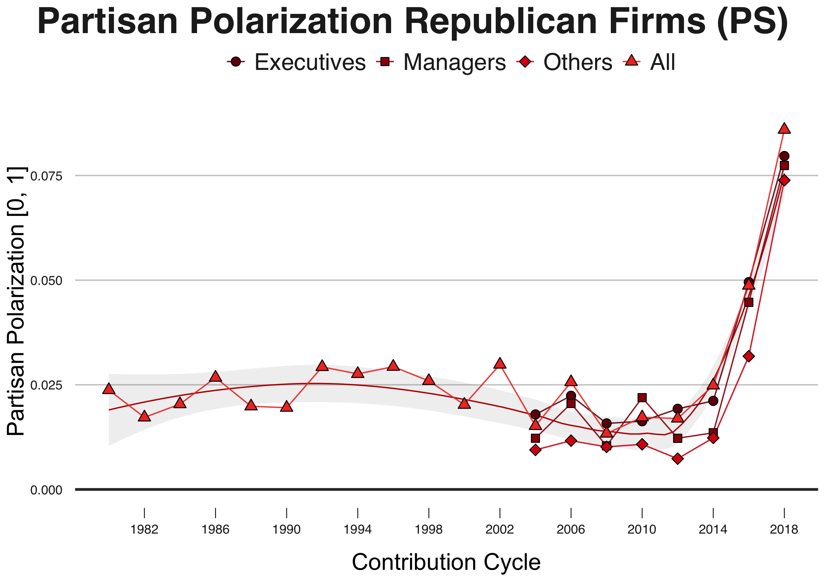
Partisan Polarization: Republican Firms Dynamic Time Warping, Agnes-Ward Model 1980-2018 with Post-Model Partisan Validation
Partisan Polarization (Party ID)
Partisan Polarization (Partisan Score)
Notes:
AGNES Models Run with 2004-2018 Period, Polarization Assessed for Respective Clusters for 1980-2018

Slide 30
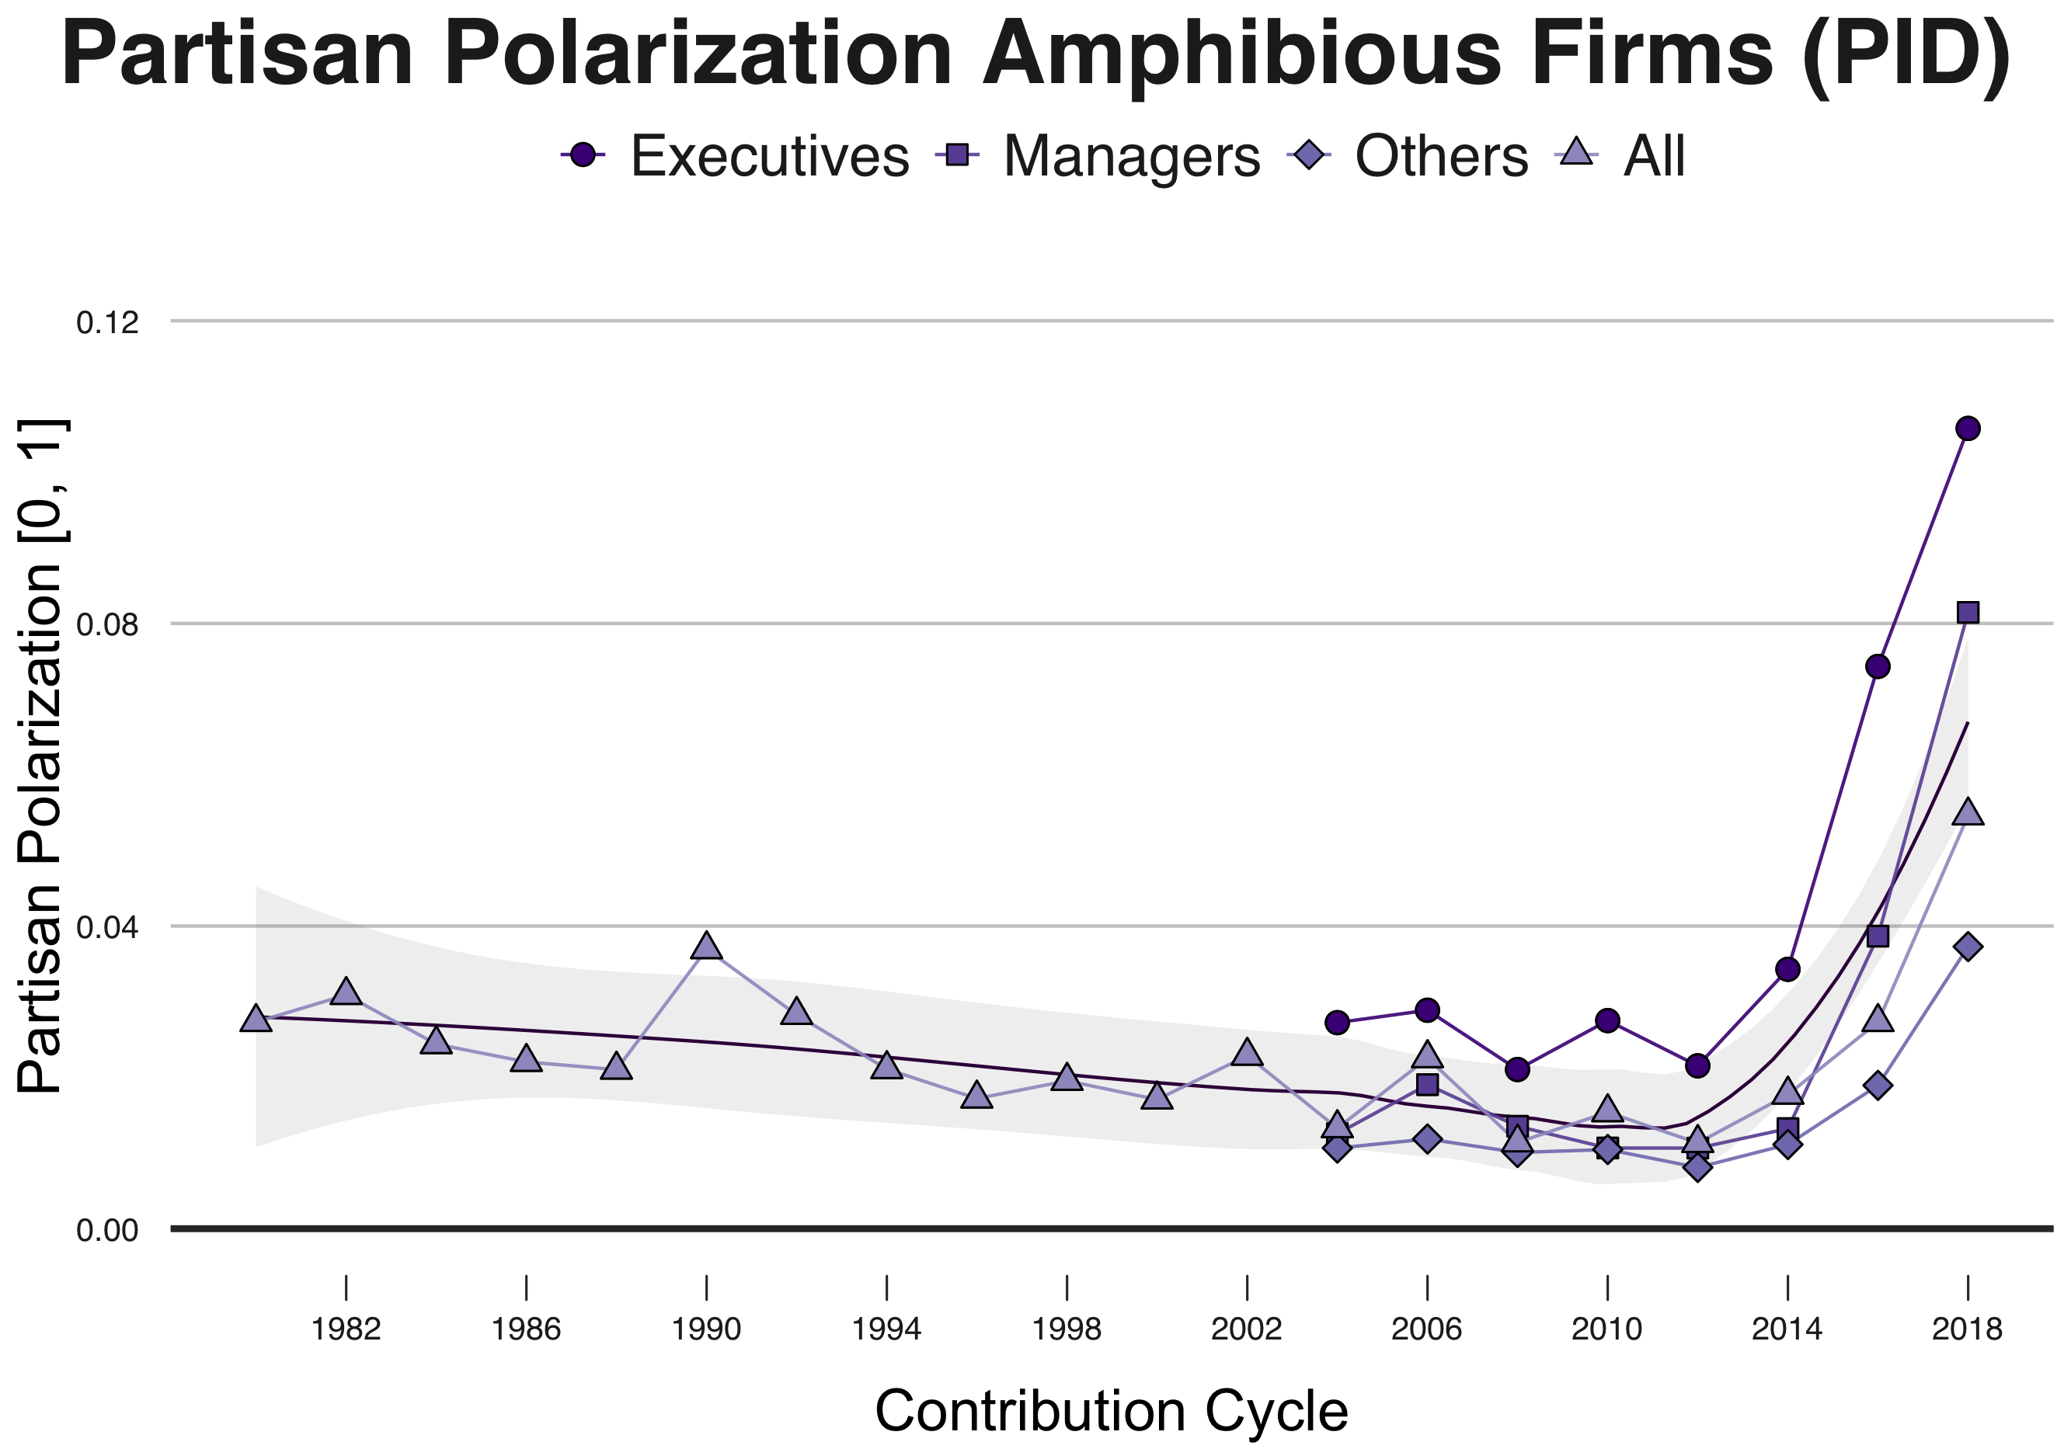
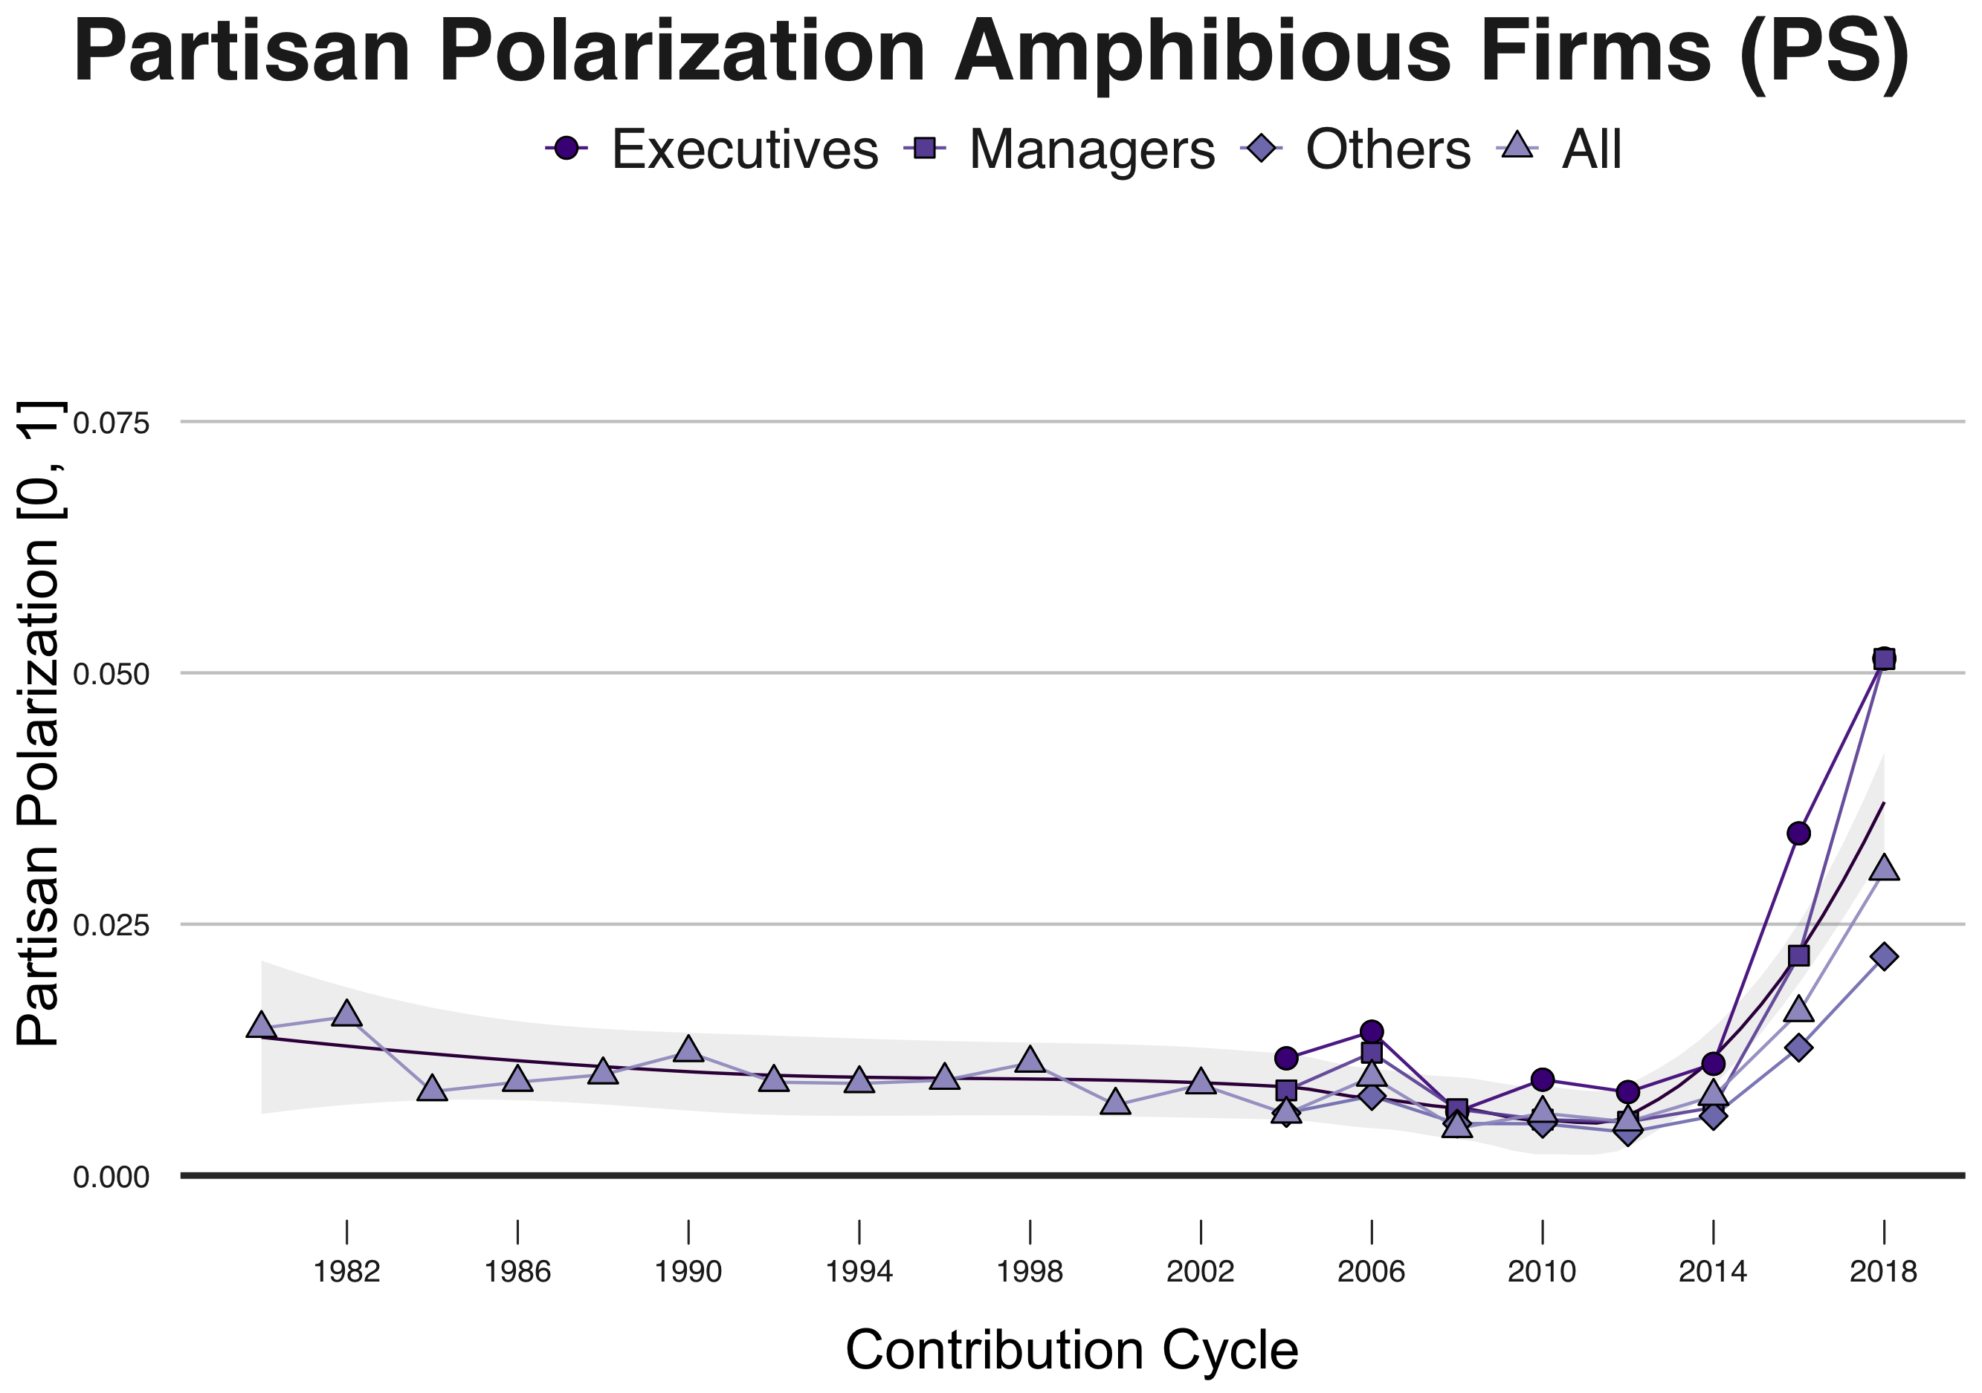
Partisan Polarization: Amphibious Firms Dynamic Time Warping, Agnes-Ward Model 1980-2018 with Post-Model Partisan Validation
Partisan Polarization (Party ID)
Partisan Polarization (Partisan Score)
Notes:
AGNES Models Run with 2004-2018 Period, Polarization Assessed for Respective Clusters for 1980-2018

Slide 31
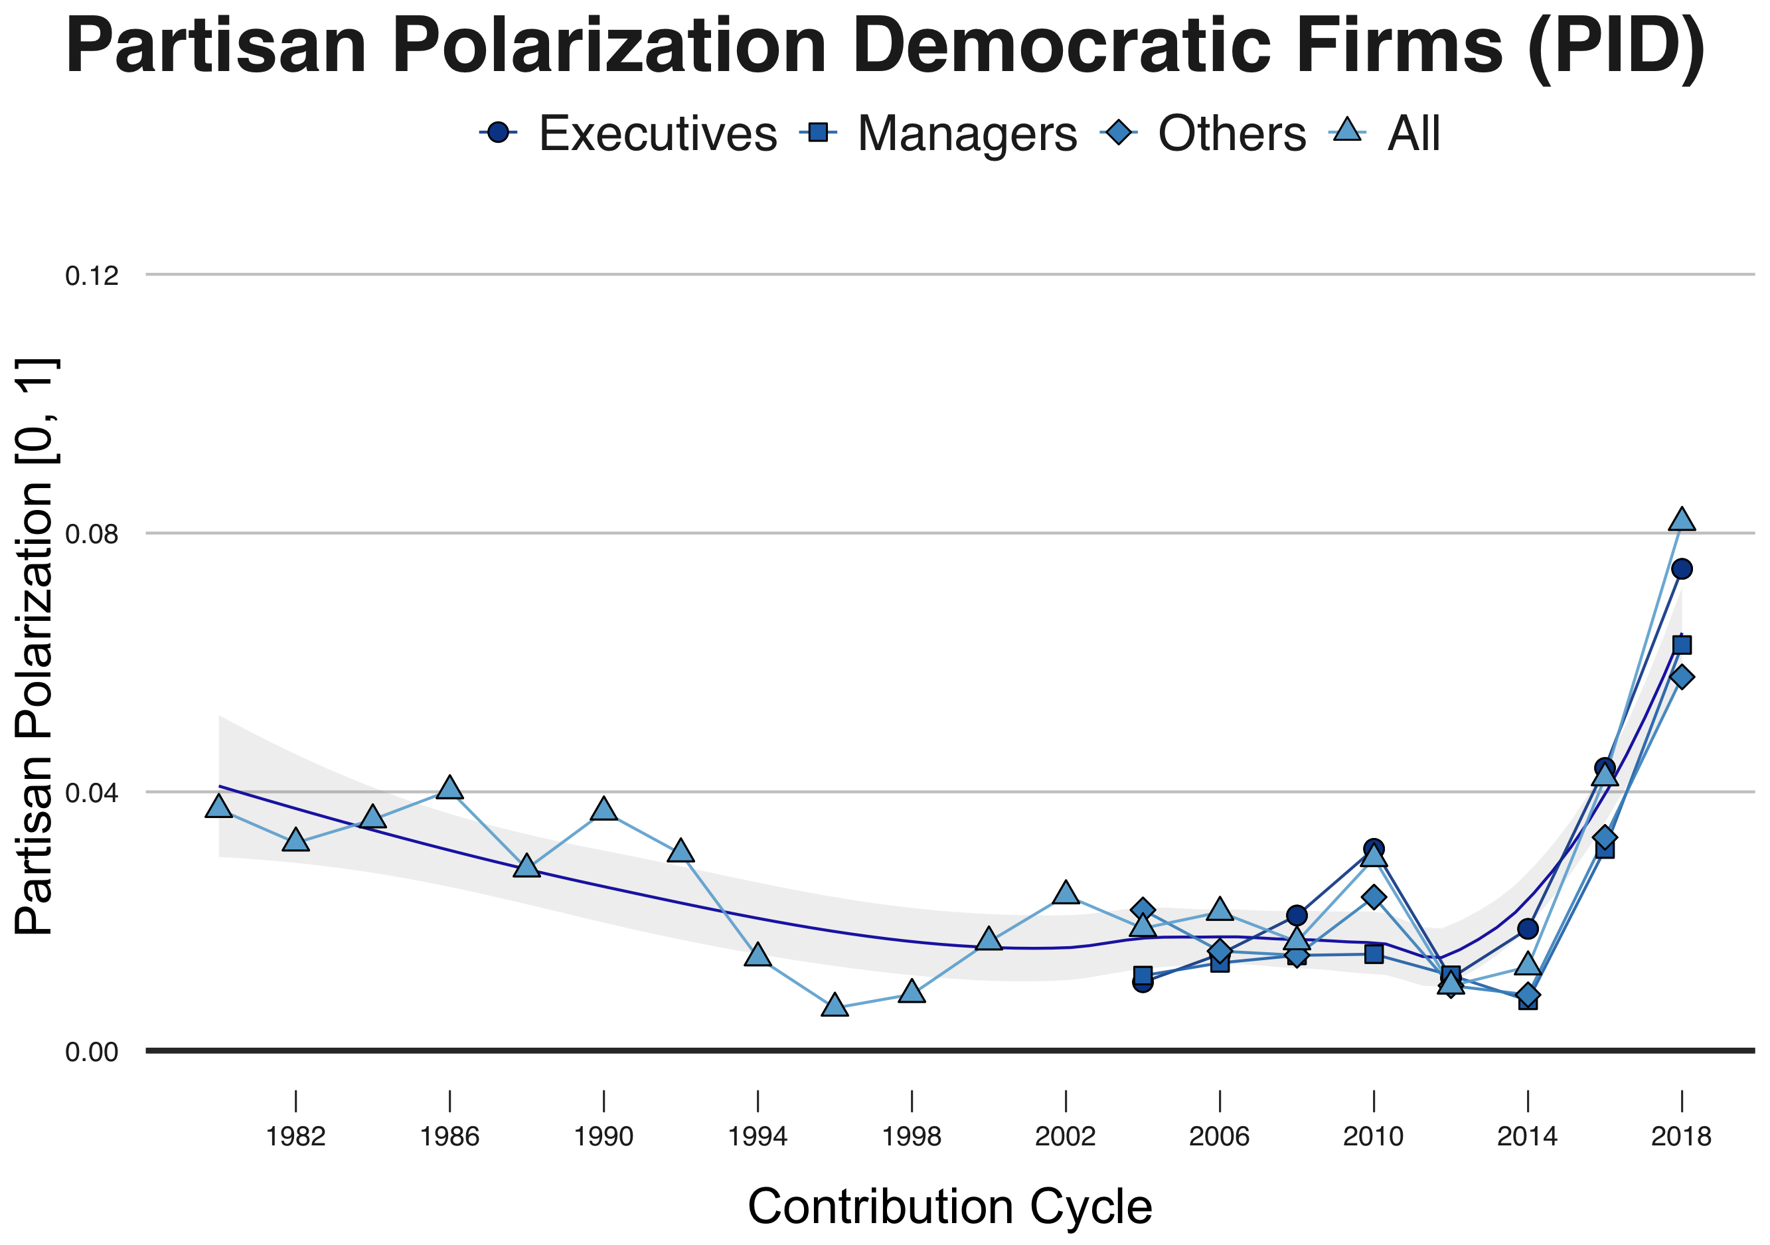
Partisan Polarization: Democratic Firms Dynamic Time Warping, Agnes-Ward Model 1980-2018 with Post-Model Partisan Validation
Partisan Polarization (Party ID)
Partisan Polarization (Partisan Score)
Notes:
AGNES Models Run with 2004-2018 Period, Polarization Assessed for Respective Clusters for 1980-2018

Slide 32
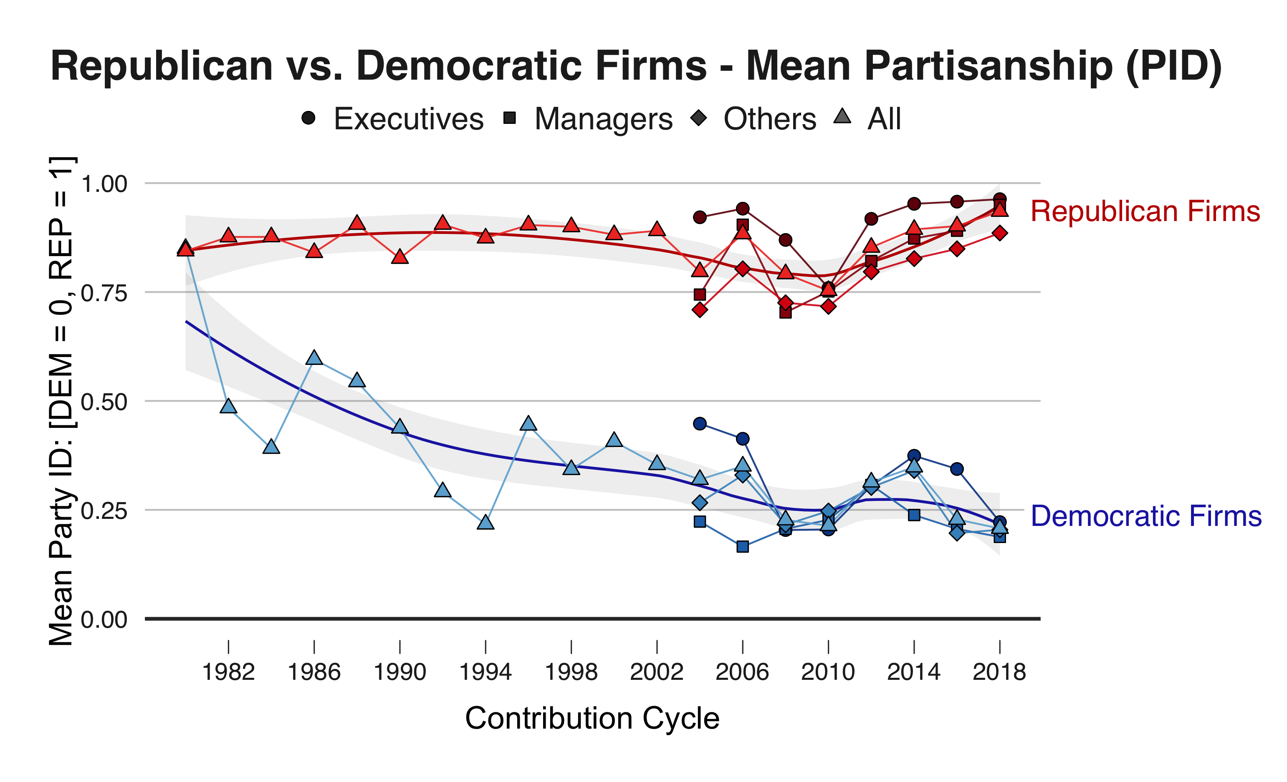
Growing Partisan Polarization Between Firms
Notes:
AGNES Models Run with 2004-2018 Period, Polarization Assessed for Respective Clusters for 1980-2018

Slide 33
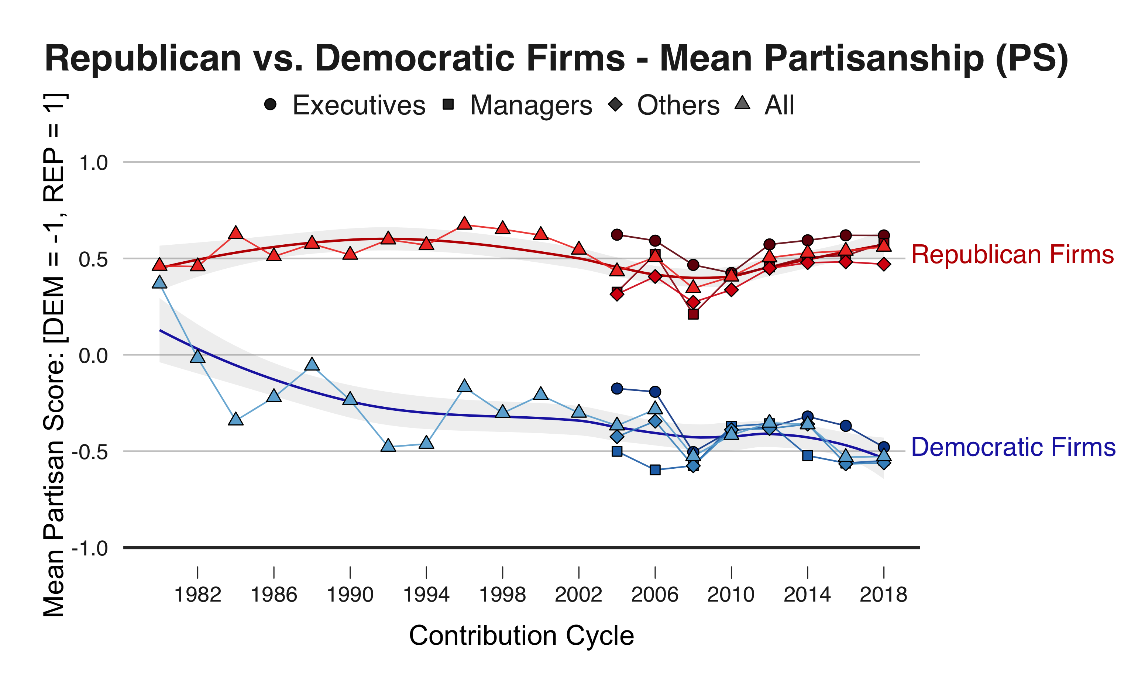
Growing Partisan Polarization Between Firms
Notes:
AGNES Models Run with 2004-2018 Period, Polarization Assessed for Respective Clusters for 1980-2018

Slide 34
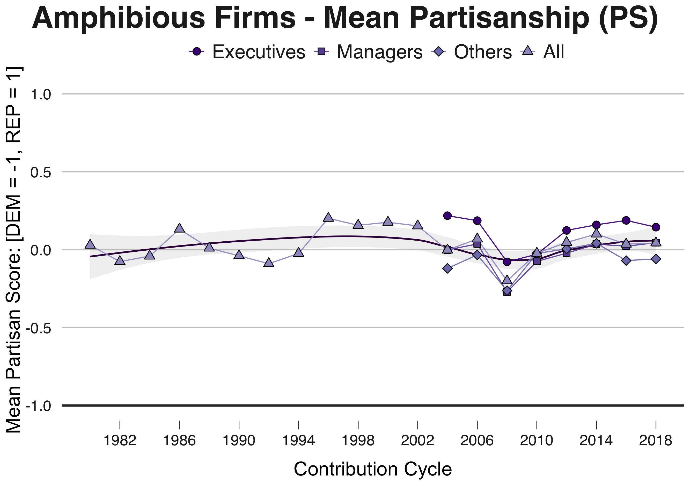
Growing Partisan Polarization Between Firms
Notes:
AGNES Models Run with 2004-2018 Period, Polarization Assessed for Respective Clusters for 1980-2018

Slide 35
Is Employee Partisanship Associated with Firm Behavior?
Notes:
To answer this question, I used MSCI data, which is a third party agency which rates companies based on how well or poorly they perform on Environmental, Social, and Governance issues

Slide 36
MSCI Environmental, Social, and Governance Ratings vs. Dynamic Time Warping HCA Classified Firm Types
Republican Firms:
Significant positive correlation with
Number of Environmental Practice Concerns
No Minorities on Board of Directors
No Women on Board of Directors
Significant negative correlation with
Number of Diversity Strengths
Progressive Gay or Lesbian Policies
Employment of the Disabled
Board of Directors – Strong Gender Diversity
Notes:
AGNES Models Run with 2004-2018 Period, Polarization Assessed for Respective Clusters for 1980-2018

Slide 37
MSCI Environmental, Social, and Governance Ratings vs. Dynamic Time Warping HCA Classified Firm Types
Democratic Firms:
Significant positive correlation with
Labor Rights Strength
Significant negative correlation with
Anti-Competitive Business Practices
Number of Employee Relations Concerns
Union Relations Concerns
Corporate Governance Concerns
Environmental Practice Concerns
Diversity Concerns
Notes:
AGNES Models Run with 2004-2018 Period, Polarization Assessed for Respective Clusters for 1980-2018

Slide 38
MSCI Environmental, Social, and Governance Ratings vs. Dynamic Time Warping HCA Classified Firm Types
Amphibious Firms:
Significant positive correlation with
Anti-Competitive Business Practices
Number of Employee Relations Concerns
Corporate Governance Concerns
Environmental Practice Concerns
Number of Diversity Strengths
Progressive Gay and Lesbian Policies
Employment of the Disabled
Board of Directors – Gender Diversity
Significant negative correlation with
Board of Directors – No Minorities
Board of Directors – No Women
Notes:
AGNES Models Run with 2004-2018 Period, Polarization Assessed for Respective Clusters for 1980-2018

Slide 39
Conclusions
Partisan polarization across firms has increased, particularly after 2014 during the 2016 election cycle.
Firms can be classified as democrat, republican, or amphibious firms, and these classifications translate to discrete firm behaviors.
A number of mechanisms might explain these changes. Long run changes might be explained by selection and discrimination mechanisms (affective polarization), but short term rapid gains are perhaps better explained by the activation of existing employee partisanship.
Further research on both fronts should be considered.

Slide 40
Thank You
Joshua Gary Mausolf The University of Chicago jmausolf@uchicago.edu jmausolf.github.io

Slide 41
Appendix Slides: Fortune 100

Slide 42
Data for Fortune 100 Companies
Data for Filtered Fortune 100 Companies, Post Quality Control (ETL) 1980-2018
Data Level | Total Observations | Years Covered
Individual Contributions | 2,709,772 | 1980-2018
Individuals x Firm x Election Cycle | 396,502 | 1980-2018
Firms | 106 | 1980-2018

Slide 43
Hierarchical Clustering Algorithm Selection HCA Used To Study Organizational Emergence (Powell and Sandholtz 2012)
HCA Evaluation, 1980-2002
Model, Method | Coefficient
DIANNA | 0.65
AGNES, UNGMA | 0.53
AGNES, WPGMA | 0.57
AGNES, Single Linkage | 0.49
AGNES, Complete Linkage | 0.67
AGNES, Ward’s Method | 0.84
HCA Evaluation, 2004-2018
Model, Method | Coefficient
DIANNA | 0.67
AGNES, UNGMA | 0.49
AGNES, WPGMA | 0.54
AGNES, Single Linkage | 0.45
AGNES, Complete Linkage | 0.70
AGNES, Ward’s Method | 0.88
Notes:
Euclidian Distance Used

Slide 44
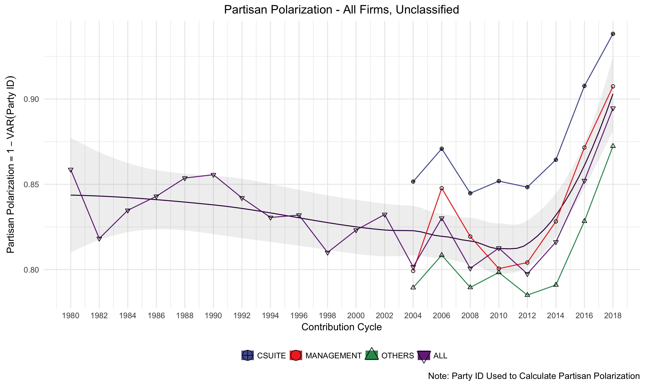
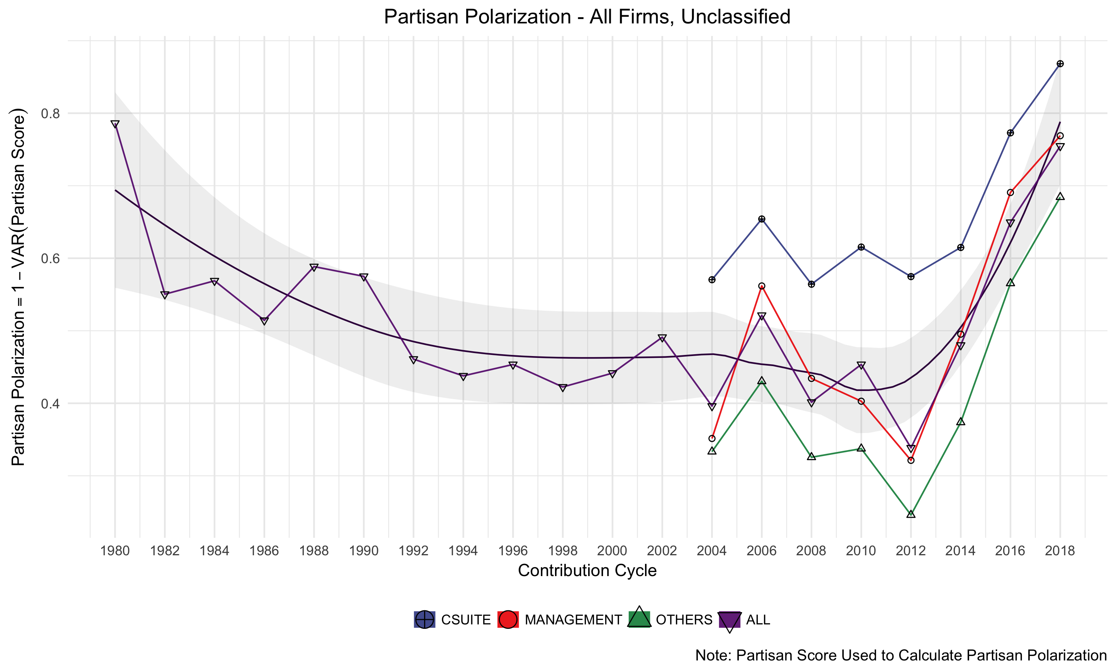
Partisan Polarization (Using Variance) in Fortune 100 Firms, 1980-2018
Partisan Polarization (Party ID)
Partisan Polarization (Partisan Score)
Notes:
AGNES Models Run with 2004-2018 Period, Polarization Assessed for Respective Clusters for 1980-2018

Slide 45
Explaining the Rise in Partisan Polarization
Notes:
Recalling our ideas of organizational emergence, fitting in, and firm bias as it relates to affective polarization, how might we explain the rise in partisan polarization?
While the given data and analyses cannot causally demonstrate any explanation, the particular trend in partisan polarization in firms is interesting, namely because so much of the change arose following the 2014 election cycle, that is in 2015 and 2016 during the 2016 presidential election.
While employee self selection into or out of firms and matching may have measurable effects, particularly in the long term, the type of rapid change exemplified better suggests that current employees might have become more politically motivated, particularly during the 2014-2016 period. That is, an activation of partisan identification.

Slide 46
Activation of Partisanship Starting 2014-2016?
Republican Polarization (Partisan Score)
Democrat Polarization (Partisan Score)
Notes:
AGNES Models Run with 2004-2018 Period, Polarization Assessed for Respective Clusters for 1980-2018

Slide 47
Activation of Partisanship Starting 2014-2016?
Average Individuals Per Firm
Total Individual Contributors
Notes:
AGNES Models Run with 2004-2018 Period, Polarization Assessed for Respective Clusters for 1980-2018

Slide 48
Dynamic Time Warping Model 1 Features
Model 1 (336 X 51 X 20)
Mean Party ID [DEM, REP] | Variance Party ID [DEM, REP] | Variance Partisan Score
Median Party ID [DEM, REP] | Skewness Party ID [DEM, REP] | Skewness Partisan Score
Mean Partisan Score | LN Kurtosis Party ID [DEM, REP] | LN Kurtosis Partisan Score
Median Partisan Score | Polarization Party ID Base
Mean Partisan Score (Mode) | Polarization Partisan Score Base
Mean Partisan Score (Min) | Polarization Party ID [0, 1] Scaled
Mean Partisan Score (Max) | Polarization Partisan Score [0, 1]
all model features are Company X Occupational Hierarchy X Cycle
336 Companies X (17 Features X 3 Hierarchies = 51) X 20 Election Cycles
Notes:
I elected to select Model 1, which incorporates a variety of measures of central tendency regarding partisanship at discrete levels of occupational hierarchy by election cycle.

Slide 49
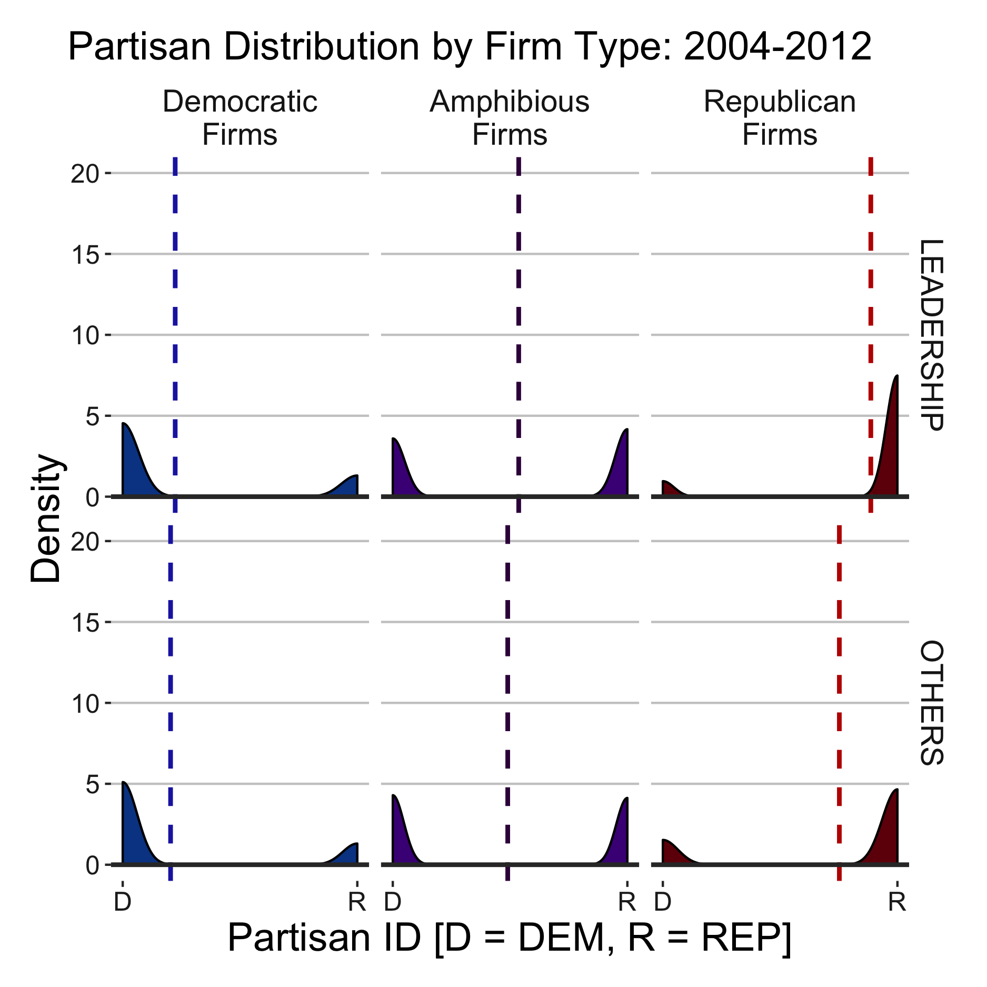
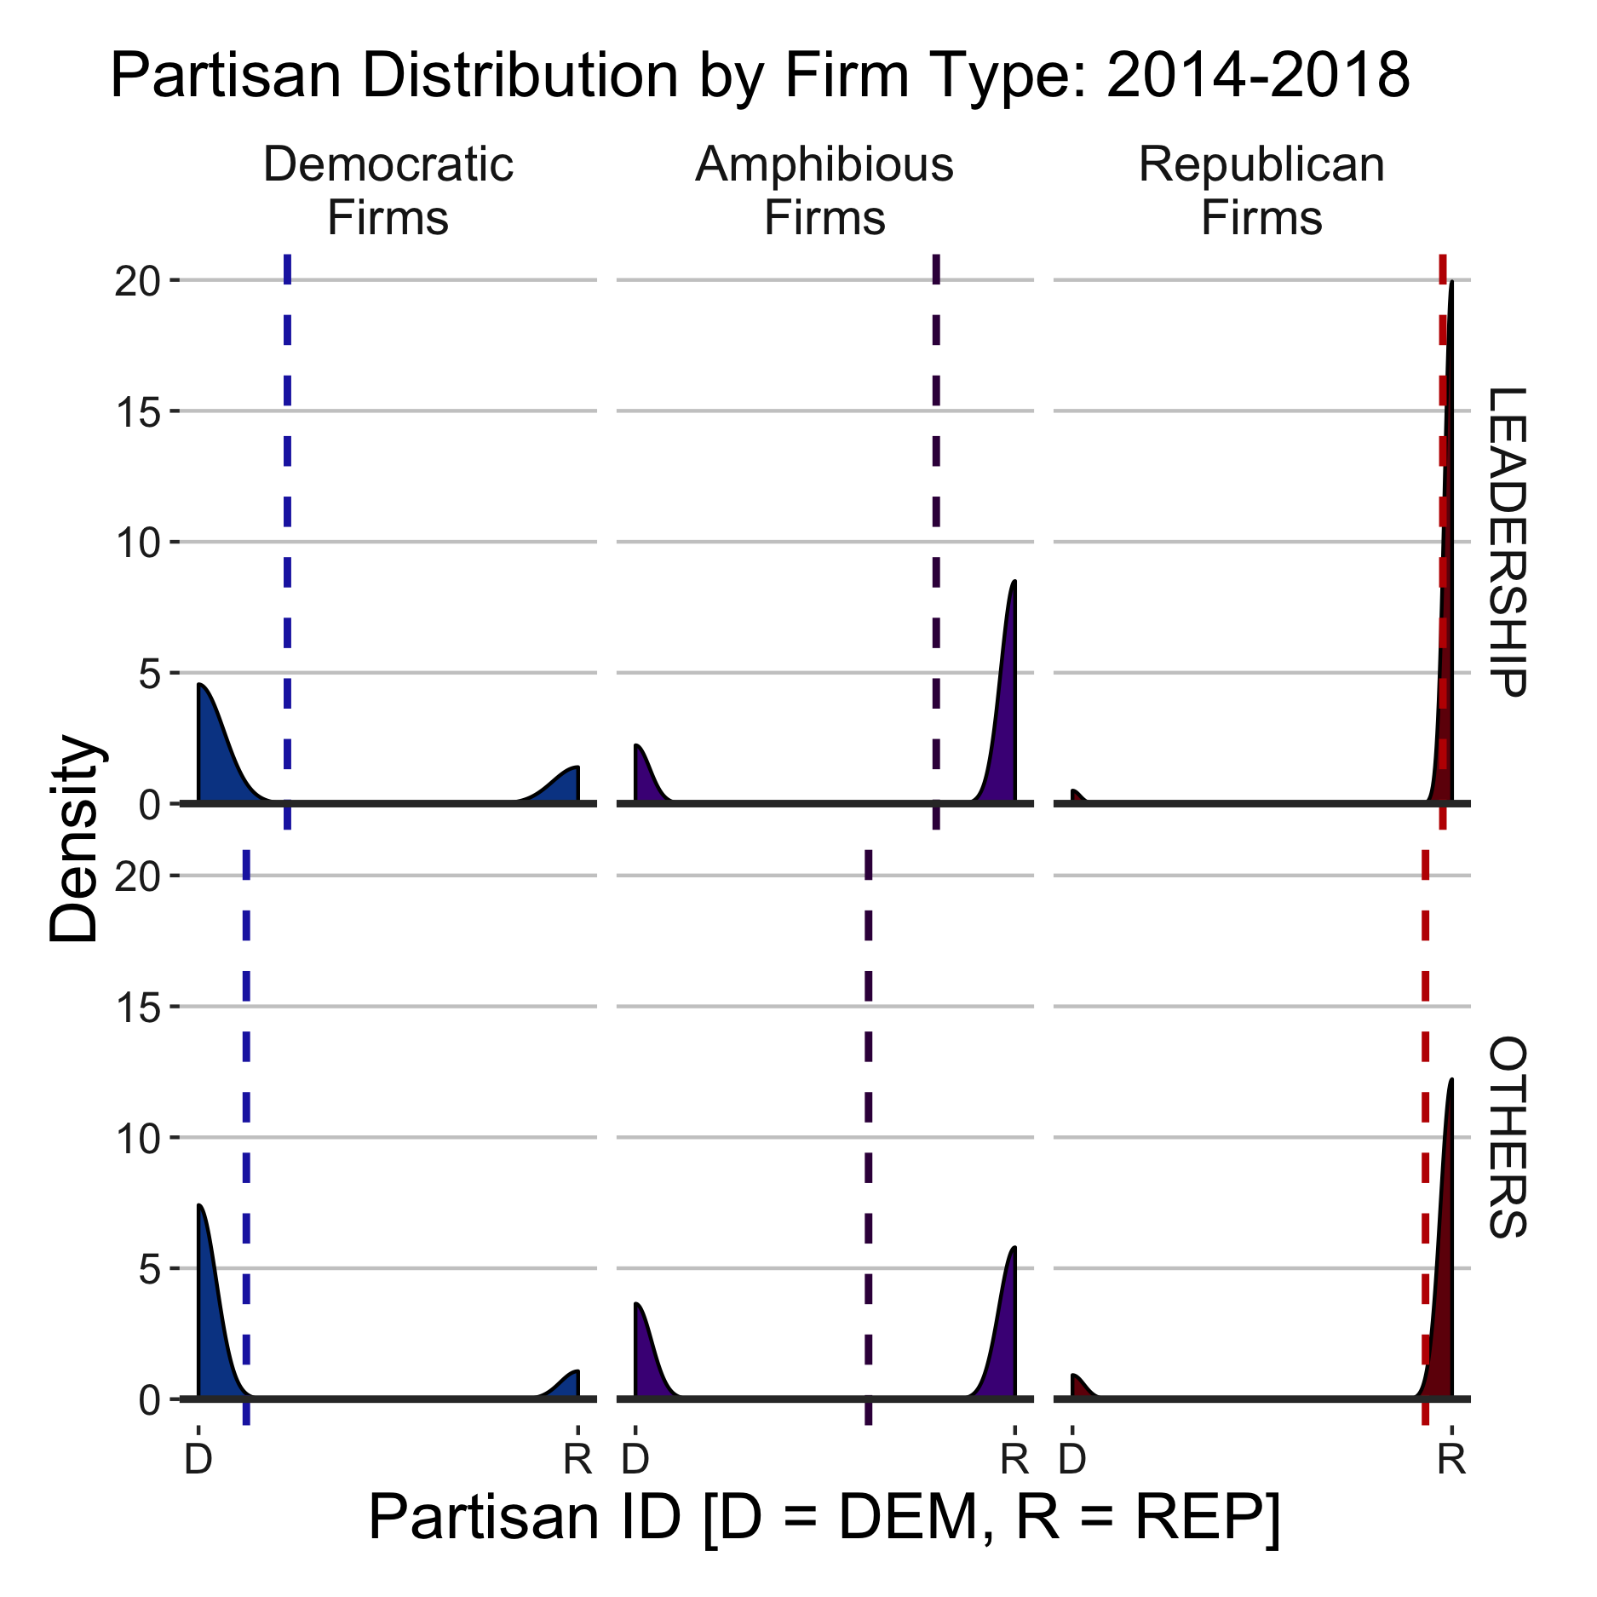
Comparing Partisan Polarization by Firm Type and Hierarchy
Notes:
We can similarly see these trends using a histogram approach.
Here, we can see two points. Within firm partisan homogeneity increases, especially at democratic and republican firms from 2014-2018
Second, while leadership is most homogeneous in republican firms, in democratic firms, it is other, non-leadership personnel who are most aligned.

Slide 50
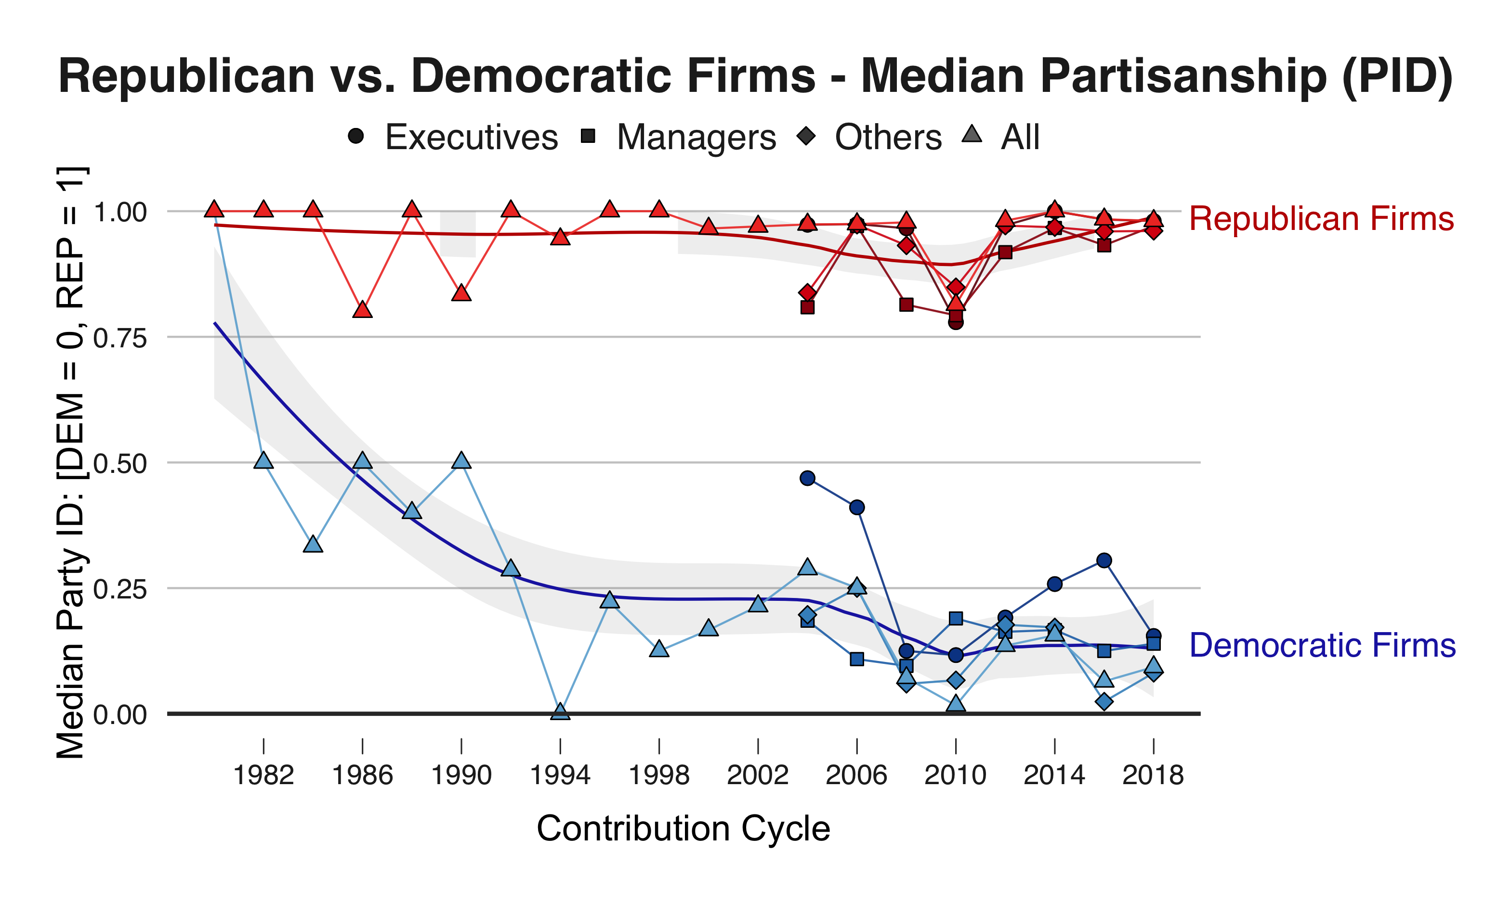
Growing Partisan Polarization Between Firms
Notes:
AGNES Models Run with 2004-2018 Period, Polarization Assessed for Respective Clusters for 1980-2018

Slide 51
Growing Partisan Polarization Between Firms
Notes:
AGNES Models Run with 2004-2018 Period, Polarization Assessed for Respective Clusters for 1980-2018

Slide 52
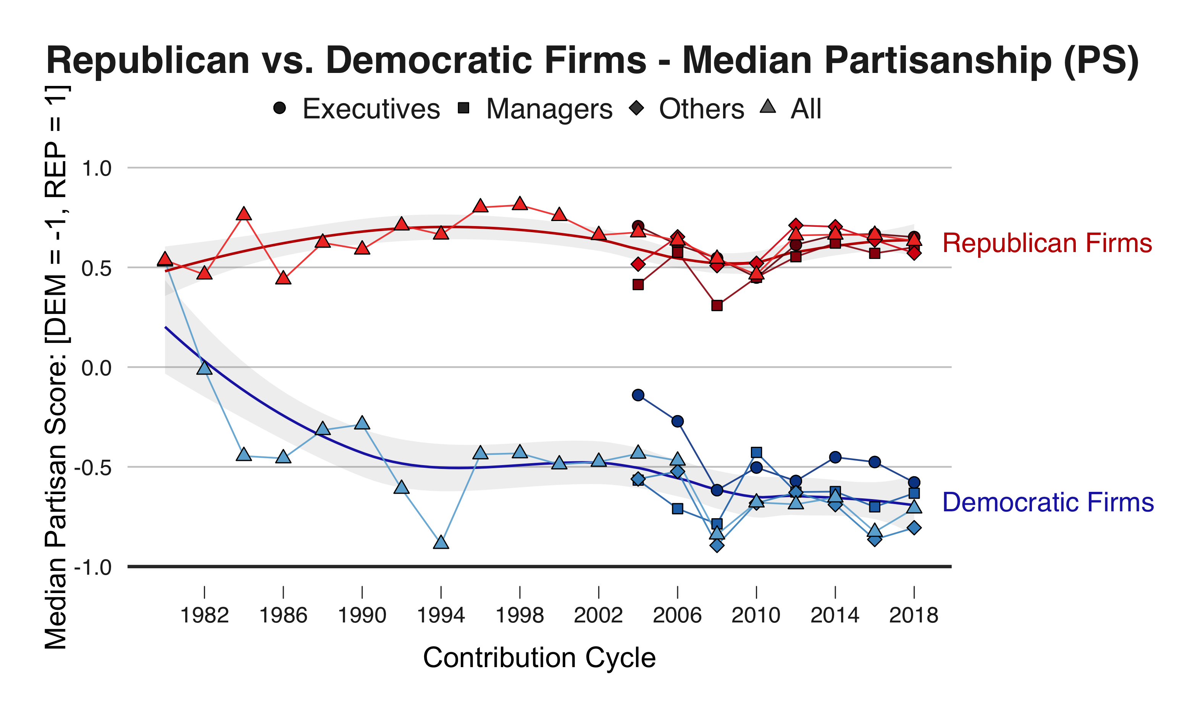
Growing Partisan Polarization Between Firms
Notes:
AGNES Models Run with 2004-2018 Period, Polarization Assessed for Respective Clusters for 1980-2018

